Slide 1
Paper Simulations of Digital Games
Stone Librande
Lead Designer, Riot Games

Slide 2
Take a digital game…

Slide 3
…remove the controller…

Slide 4
…remove the controller…

Slide 5
…the sound and music…

Slide 6
…the sound and music…

Slide 7
…and the graphics

Slide 8
…and the graphics

Slide 9
What’s left?

Slide 11
Paper Simulation
Simulate a video game using only pencils, index cards and dice.
Use it as a tool to help understand the game’s fundamental design principles.
Don’t sweat the details.

Slide 12
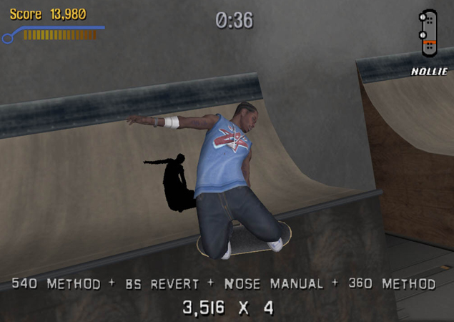
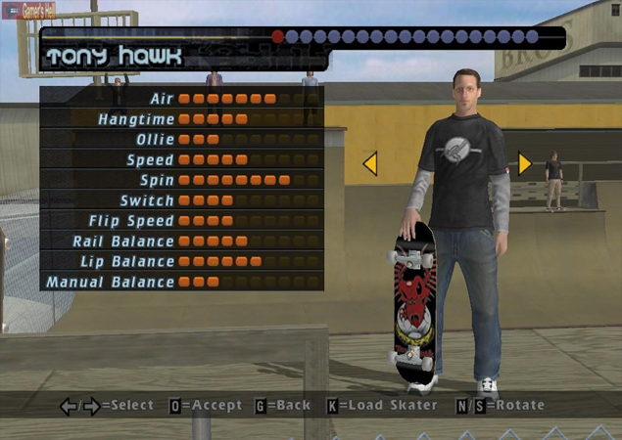
Example Game
Tony Hawk’s Pro Skater

Slide 13
Example Game
Tony Hawk’s Pro Skater

Slide 14
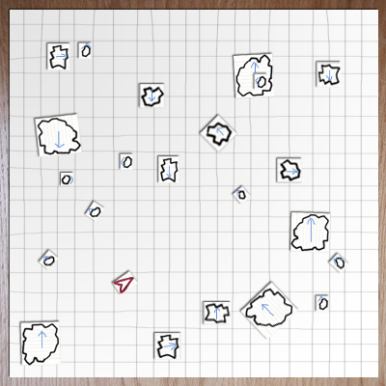
Asteroids

Slide 15
Asteroids

Slide 16
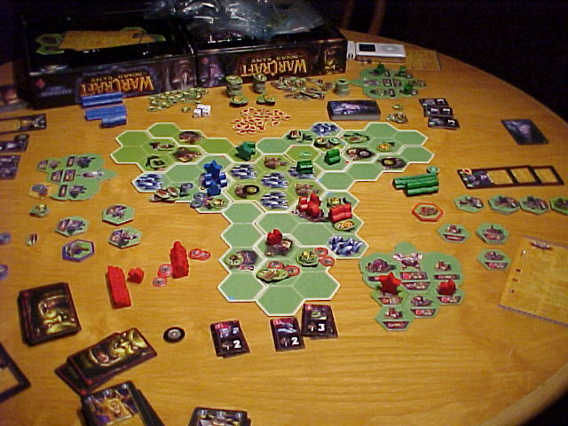
Warcraft
The Board Game

Slide 17
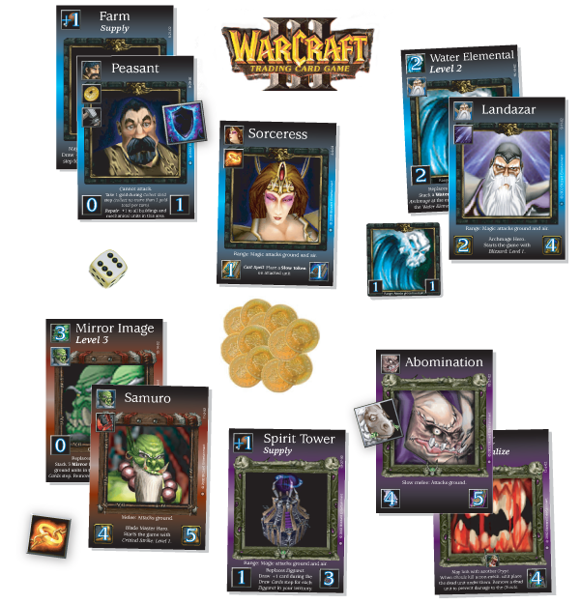
Warcraft
The Card Game
Notes:
Warcraft card game
Headhunter example

Slide 18
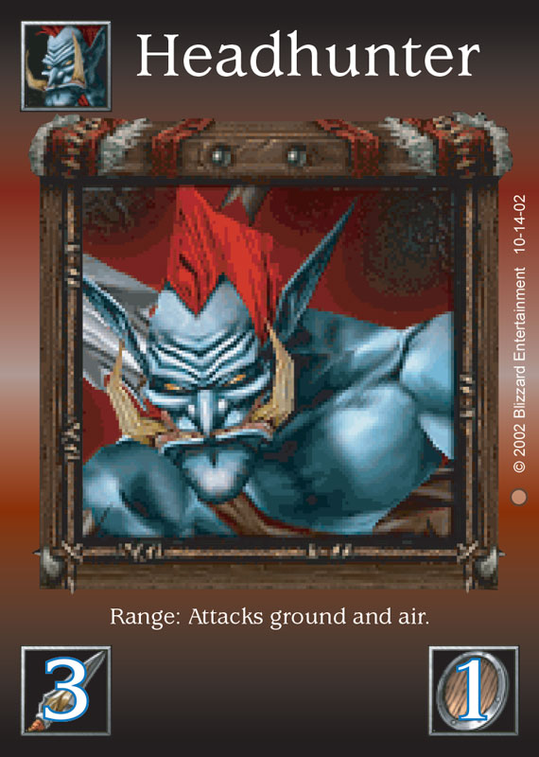
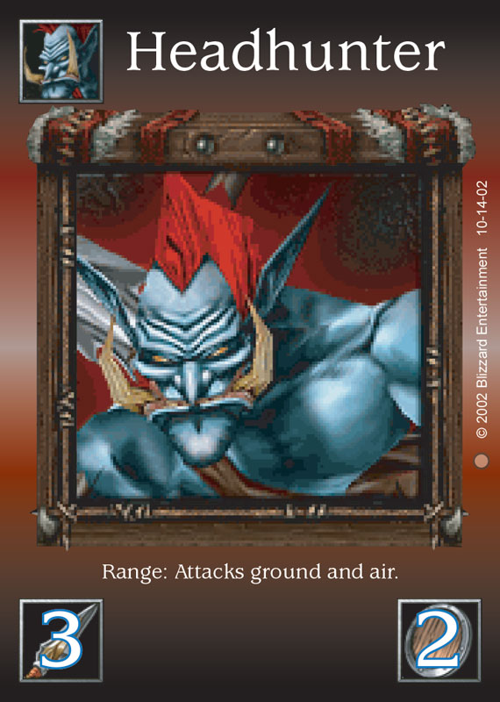
Warcraft
The Card Game

Slide 19
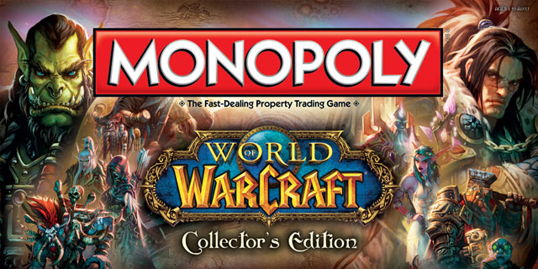
Notes:
Diablo card game
Kill monsters, get treasure, buy better stuff, kill bigger monsters, get bigger treasures…

Slide 20
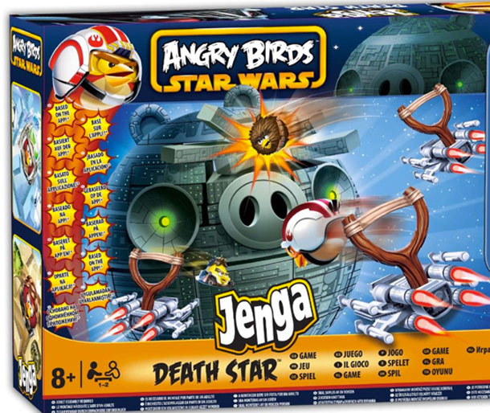

Slide 21
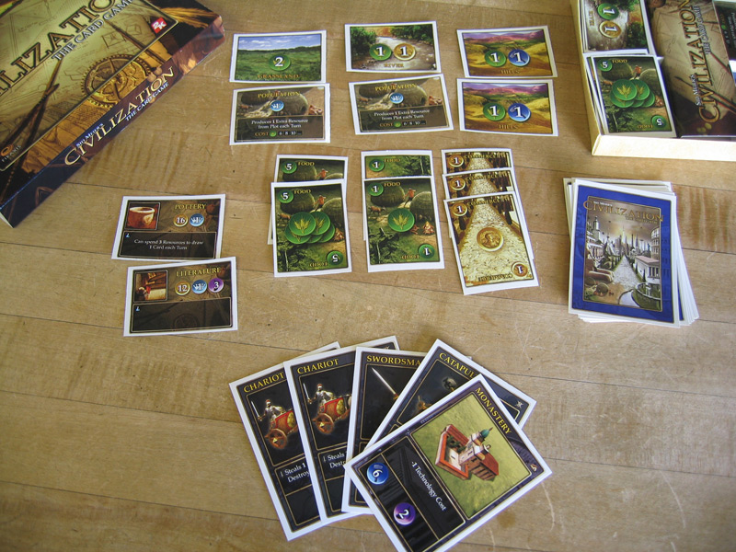
Civilization
The Card Game

Slide 22
Exercise
Select a digital game
Make a paper prototype
What aesthetics survive the change in medium?

Slide 23
Brainstorm
Name some games to “unplug”
Break into small groups

Slide 24
First Steps
Write down three emotions you feel when playing the game.
Pick one of the three to try to capture with your prototype.
Write down your choice and put it in the middle of your table.

Slide 25
Build a Paper Version
What to do:
Focus on the one emotion you picked.
Identify the game actions that create that feeling

Slide 26
Build a Paper Version
What not to do:
Don’t sweat the details
Don’t try to duplicate the whole game
Don’t focus on simulating computer functions
Don’t make a board!

Slide 27
Lunch
Read about electives on gdc.8kindsoffun.com or tinyurl.com/gdc-mda
Continue work at 1:30

Slide 28
Alpha Deadline at 2:00
Try to have something playable quickly!
Iterate!

Slide 29
How do we get from…
Cards
Dice
Rules
Notes:
29

Slide 30
To…
Cards
Dice
Rules
Discovery
Challenge
Drama
Notes:
30

Slide 31
What’s missing?
“Rules”
“Fun”
Notes:
31

Slide 32
The causal link…
“Rules”
“Activity”
“Fun”
This is what sets games apart…
Notes:
32

Slide 33
Games As Software
“Rules”
“Activity”
“Fun”
Code
Process
Requirements
Notes:
33

Slide 34
This is a systems view of games.
Input
Output
Logic
State

Slide 35
A Design Vocabulary
“Rules”
“Activity”
“Fun”
Code
Process
Requirements
Notes:
35

Slide 36
A Design Vocabulary
Mechanics
“Activity”
“Fun”
Process
Requirements
Notes:
36

Slide 37
A Design Vocabulary
Mechanics
Dynamics
“Fun”
Requirements
Notes:
37

Slide 38
A Design Vocabulary
Mechanics
Dynamics
Aesthetics
Notes:
38

Slide 39
The MDA Framework
Mechanics
Dynamics
Aesthetics
Notes:
39

Slide 40
The MDA Framework
Mechanics
Dynamics
Aesthetics
What do we mean?
Notes:
40

Slide 41
Mechanics
The concepts and materials that formally specify the game-as-system.
Everything you need to play.
Not just rules
Not just “Systemic Building Blocks”
Not “Technical execution of moves by players.” (eSports)

Slide 42
Dynamics
The run-time behavior of the game-as-system.
What happens when you play.

Slide 43
Aesthetics
The emotional content of the game.
How players feel when they play.
Not just visual or sensory qualities.
Cognitive rather than Behavioral

Slide 44
The Designer/Player Relationship


Mechanics
Dynamics
Aesthetics
Designer
Player
Notes:
44

Slide 45
The Player’s Perspective

Mechanics
Dynamics
Aesthetics
Player
Notes:
45

Slide 46
The Designer’s Perspective

Mechanics
Dynamics
Aesthetics
Designer
Notes:
46

Slide 47
MDA
A “Taxonomy” of Design Knowledge
Aesthetics
Dynamics
Mechanics
…and the interactions between them.
Notes:
47

Slide 48
Beta Test at 2:45
Make sure your rules are written down.

Slide 49
Beta Test
Send two testers to other tables.
Test until 3:15

Slide 50
Discussion

Slide 51
Using Paper Prototypes
Good for understanding existing games.
Use these techniques for games in progress.
Process is quick and cheap.
You don’t need programmers or artists.

Slide 52
Using Paper Prototypes
Can’t replace actual gameplay testing.
Can give you a head start and keep you focused.
Creates a vocabulary to use when discussing your game.
Can be used as a tool to educate other team members. Have them play, too!

Slide 53
Short Break Electives Start at 3:35
Elective | Room
Game of Games | 120
Meaning as a Mechanic | 121
Us vs. It | 122
Games That Teach | 123
Horns of a Dilemma | 124
Design Jam | 125

