Slide 1
Mechanics & Meaning Andy Ashcraft Daniel Cook Marc LeBlanc

Slide 2
Topic: ‘Meaning’ Affects Dynamics
We (Game Designers) say what each button or each tap means
Meaning can come from the player’s built in expectations
Meaning can come from extrinsic and intrinsic rewards
Meaning can come from the fiction: the labels that we add
Notes:
Start: 2:40

Slide 3
What do you mean by ‘Meaning’?
Meaning is what the game is about (if anything)
Meaning is the IDEA that attaches to an event in our minds
Meaning can make us CARE
Notes:
Dan’s story about player’s risking Freezing to death to save people, but not for currency

Slide 4
Games without ‘Meaning’?
Yahtzee, Craps, many sports
Traditional card games
What does it MEAN to win a hand of Poker?
You’re wealthier than you were - stakes!
“Good at Poker” (Lucky? Skilled? Cool?)

Slide 5
Players will ADD Meaning
“Last one home’s a rotten egg!”
Increase the stakes
How we play Apples to Apples
Game outcomes can define the player

Slide 6
Dane Cook on Rock-Paper-Scissors
“I understand that Scissors can beat Paper, and I get how Rock can beat Scissors, but there's no f***ing way Paper can beat Rock. … When I play Rock-Paper-Scissors I always choose Rock. Then when somebody claims to have beaten me with their Paper I can punch them in the face with my already clenched fist and say "oh s**t I'm sorry, I thought Paper would protect you, a**hole.”

Slide 7
Rock-Paper-Scissors
Lame fiction

Slide 8
Rock-Paper-Scissors
Lame fiction, BUT
Memorable
Simple gestures

Slide 9
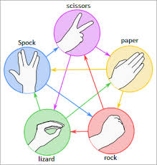
Rock-Paper-Scissors
Lame fiction, BUT
Memorable
Simple gestures
Has been hacked expanded to…

Slide 10
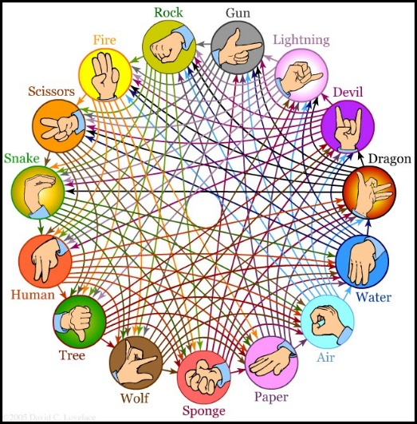
Rock-Paper-Scissors
Or this…
Hilariously complex
Neither Memorable nor Simple
Playable?

Slide 11
Rock-Paper-Scissors
Common mechanic for lots of games:
Punch → Kick → Throw → Punch
Archers → Pikemen → Cavalry → Archers
Orange → Blue → Yellow → Orange
Breeding strategies for a type of lizard!
Yay, Wikipedia!

Slide 12
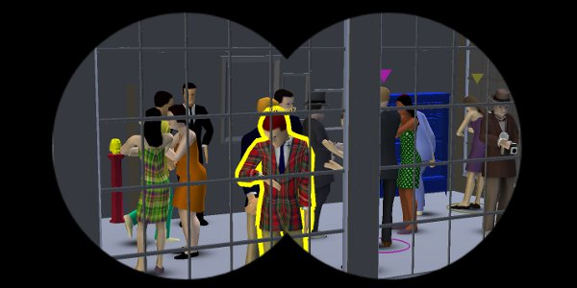
SpyParty by Chris Hecker
Player 1 is a Spy at a cocktail party
Player 2 is a Sniper with one bullet

Slide 13
SpyParty by Chris Hecker
What if Player 2 is an Informant who can just tap the Spy to expose him?
Point and click
Same mechanic, different label
One PLAYS differently

Slide 14
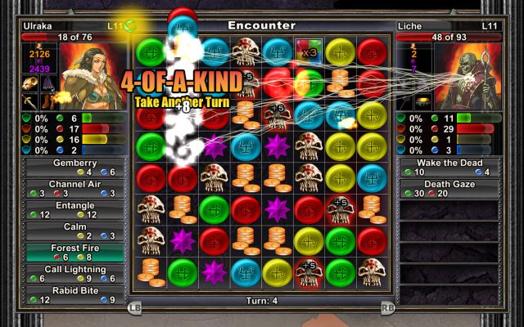
Puzzle Quest by Steve Fawkner
Standard Match-3 style game
Each symbol has a different meaning
Players customize the meaning as they play

Slide 15
Meaning is an Input
Like Code and Story and Hardware
Meaning is controlled by Designers
In MDA terminology: Meaning is another element of a game’s Mechanics.

Slide 16
Activity Stage 1 until 3:15
1 Game Pack per Table
Play that game until you understand it
Each person should play at least once
Keep track of the choices players make
Keep track of the results of each game
Find the equilibrium between the risky and cooperative strategies
Notes:
Start at 2:55- End at 3:15

Slide 17
Activity Stage 2 Until 3:30
Create a STORY to explain the game
Give meaningless mechanics a meaning
Do NOT change ANY mechanic
DO use the fiction to push or pull players into choosing a different strategy

Slide 18
Beta Test Until 4:00
4 from each group PLAYTEST other games
STAY & TEACH
Kleenex Testing (always new players)
Track player choices and outcomes
Data is King!
PLAYTESTERS
Spread out
Play 4 games
Play each game only once!
Track your scores

Slide 19
Discussion
Teachers: Did it work? Did the Kleenex Testers play differently than you did, pre-fiction?
Playtesters: Could you tell, in one play experience, how the game was pushing you?
What else did you notice?

Slide 20
‘Rational’ & ‘Irrational’ Actors
Game Theory terminology
Optimized Vs. Meaningful strategies
What external factors affect player choices?
Social situation & stakes
Morality
Others?

Slide 21
Types of Players
Are some players harder to ‘move’ away from ‘rational’ strategies?
Hard-core Vs. Casual players
New players Vs. Veterans
Economists? Lawyers? Game Designers?
Game design ‘literacy’?

Slide 22
Activity Stage 3 Until 4:20
ITERATE based on your data
Feel free to try a completely NEW story
Still DO NOT change ANY mechanic
Consider:
Changing the stakes
Non-symmetrical roles

Slide 23
Beta Test Until 4:50
Send 4 playtesters to play 4 NEW games.
STAY & TEACH
Sell it with story!
Kleenex Testing
Track choices and results
Data is King!
PLAYTESTERS
Spread out
Play 4 new games
Play each game once
Track your scores!

Slide 24
From A Theory of Fun – Raph Koster
“Let’s picture a game wherein there is a gas chamber shaped like a well. You the player are dropping innocent Jews down (in) … and they come in all shapes and sizes. … As they fall to the bottom, they grab onto each other and try to… get to the top of the well. Should they manage to get out, the game is over and you lose. But if you pack them in tightly enough, the ones on the bottom succumb to the gas and die.”
Notes:
“Let’s picture a game wherein there is a gas chamber shaped like a well. You the player are dropping innocent Jews down into the gas chamber, and they come in all shapes and sizes. There are old ones and young ones, fat ones and tall ones. As they fall to the bottom, they grab onto each other and try to form human pyramids to get to the top of the well. Should they manage to get out, the game is over and you lose. But if you pack them in tightly enough, the ones on the bottom succumb to the gas and die.
“I do not want to play this game. Do you? Yet it is Tetris. You could have well-proven, stellar game design mechanics applied towards a quite repugnant premise.”

Slide 25
From A Theory of Fun – Raph Koster
“I do not want to play this game. Do you? Yet it is Tetris. You could have well-proven, stellar game design mechanics applied towards a quite repugnant premise.”
There have been (at least) TWO games that have done (almost) exactly this!

Slide 26
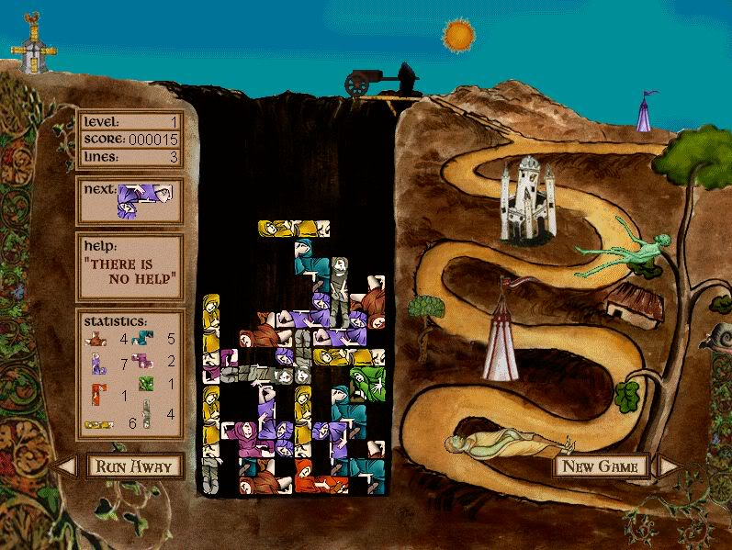
“Dead Drop”
Monty Python’s Quest for the Holy Grail
Lesley Mathieson, 1996
Tetris with Dead Bodies

Slide 27
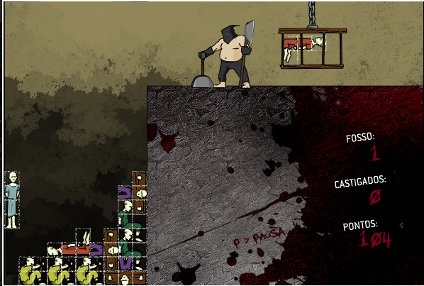
Calabouço Tétrico (Tetric Dungeon)
Raphael Aleixo, 2008
Designed in response to A Theory of Fun
(Koster noted on his website that he found it grimly unappealing, but played it anyway.)
Notes:
Two games can have different aesthetics even while the mechanics are the same.
Everyone expects Monty Python to be funny, but a relatively unknown game designer making a game about dropping bodies in a pit is kinda creepy. (screams were particularly creepy)

Slide 28
The Carrot & The Stick
Fiction can be used to push players away…
OR to draw them in,
Notes:
DANIEL’S FROZEN CHILDREN EXAMPLE.

Slide 29
Activity Stage 4 Until 5:00
ITERATE based on your data
ONE FINAL CHANGE
Still do not change ANY mechanic
Change ONLY the labels to push players toward non-optimal decisions
DON’T HOLD BACK!

Slide 30
Final Test Until 5:20
Send 4 Playtesters to play the last games.
STAY & TEACH
SELL the story!
Kleenex Testing
Track player choices and results
Data is King!
PLAYTESTERS
Spread out
Play only new games
Play each game once
Play quickly!
I have Prizes!

Slide 31
Final Discussion
What effect does the promise of a prize have on the playtesters?
Where there games you did not WANT to play because of the story?
Any final thoughts / observations?

Slide 32
Recap!
Labels and Fiction can change Meaning
Meaning directly affects Dynamics
Tension between Meaningful play and Optimized (‘rational’) play strategies

Slide 33
Thank You!
EVERYONE return to room 236 at 5:30
Q/A and final Wrap-Up
Andy Ashcraft
Daniel Cook
Marc LeBlanc

