Slide 1
Amplifying Emotions in Mechanics
4:10-6pm Monday, March 2nd

Slide 2
Schedule
4:10 Explain theory and exercise
4:30 Split into groups and play game:
4:40 Write down and prioritize emotions:
4:45 Redesign the game to amplify emotions.
5:00 Switch groups and playtest.
5:15 Redesign the game to amplify emotions.
5:30 Switch groups and playtest.
5:45 Report back

Slide 3
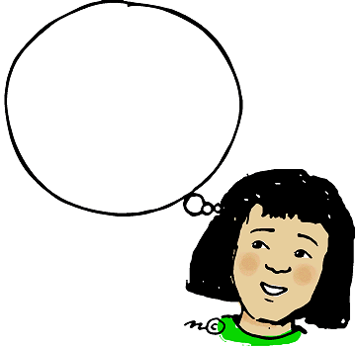
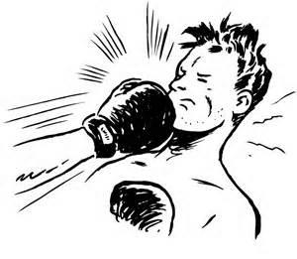
As if body Loop
Notes:
This is what we are used to when talking about emotions. I tell you an emotional story and you feel emotions.

Slide 4
As if body Loop
Evocative Stimuli
Stories
Memory matters
Boring bits culled
Processed Experience
Notes:
Rich details
Remo

Slide 5
Body Loop
Notes:
Somatic Marker theory
Being punched vs story of being punched.
Doing,

Slide 6
Body Loop
Actions
Resource change
Cost/Benefit
Social Context
Boring bits matter
Unprocessed Experience
Notes:
Process…iterative going through steps has meaning.
I am punching you. You are bleeding. You think about punching me.
Who wants a 20 dollar bill?
I want to tear it up.
Did you feel something?

Slide 7
Amplifying Emotions Process
Prototype
Amplify
Playtest & Observe
Notes:
Emotions are really complex. There’s only so much theory can help you.

Slide 8
Where to look
Who put emotions in my mechanics!

Slide 9
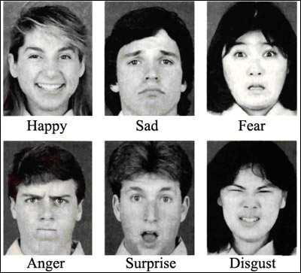
Notes:
The basic emotions: Paul Ekman: The first 5 are pretty easy to manage with mechanics alone.
Disgust is trickier and seems far more tied to the As If Body loop. For example, a person imagining that they ate something bad.

Slide 10
Primary
Emotions
Much Bigger Thing = Fear
Cognitive Labels
Mountain
American Culture
Expressed
Emotions
Awe
Notes:
Hugely contextural
Cultural display rules filter emotions so you don’t see some of them.

Slide 11
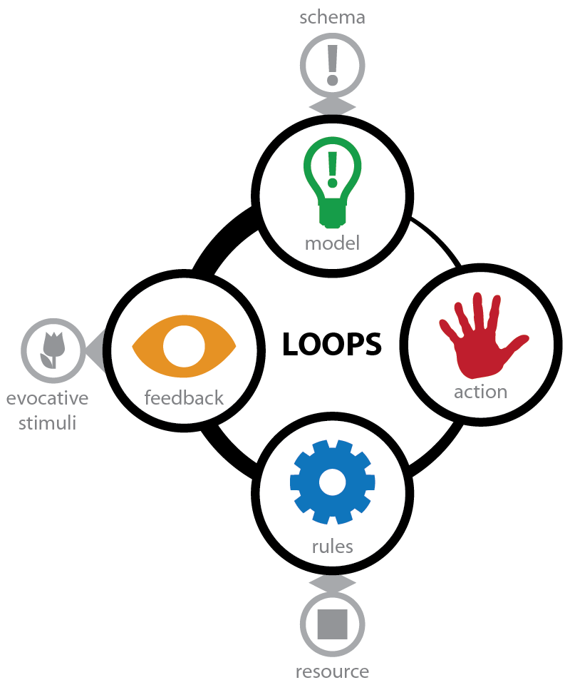
Notes:
Here’s one place to look.
Interaction loop. Games are made up of these. And each step is full of emotions.

Slide 12
Anticipation
Excitement
Fear
Guilt
Notes:
Interaction loop. Games are made up of these. And each step is full of emotions.

Slide 13
Pleasure of doing
Pain of doing
Notes:
These are actually micro loops, but inside a larger interaction loops, you’ll often see

Slide 14
Labeling
Magnitude
Context
Evocative Stimuli
Notes:
These are actually micro loops, but inside a larger interaction loops, you’ll often see

Slide 15
Excitement
Dread
Guilt
Delight (Koster)
Relief
Anger
Embarrassment
Satisfaction
Confusion
Notes:
Interaction loop. Games are made up of these. And each step is full of emotions.

Slide 16
What to tweak
Who put emotions in my mechanics!

Slide 17
Mastery: Variables for Emotions
Cause and effect: Tightness / Loosness
Timescale: Time pressure, boredom
Freedom / constraint of choice
Freedom / constrain of movement

Slide 18
Social: Variables for Emotions
Competition, Working together
Group: Forming, storming, norming, performing
Table talk, Social grooming
Trust, Betrayal, Embarrassment
Acting in sync
Look for Reciprocation processes
Notes:
These are tons here.

Slide 19
Resource: Variables for Emotions
Positive and Negative Feedback Loops
Loss and gain
Investment over time
Economic scenarios: Game Theory!
Prisoner’s Dilemma is a 2x2 Soap Opera.
Notes:
Prisoner’s Dilemma is a 2x2 Soap Opera.

Slide 20
Pacing: Variables for Emotions
Sampling, Expected value, Variability
Repetition
Non-linearity relative to expectations
Dominate and supporting frequencies
Notes:
Rates of change

Slide 21
Group up & Play Games! (10 min)
Minimum of 4 per table
Each table has a game
Read the rules and play a round or two.
Jot down the emotions you are feeling.

Slide 22
List & Prioritize Emotions (5 min)
Pick the following:
A primary emotion to amplify
A secondary emotion to provide contrast
An emotion to weaken

Slide 23
Design Time! (15 min)
Change the game mechanics to get the emotional response you want.
Punch your players. Don’t tell them a story about being punched.
Play! Iterate! Play! Chop, Chop!

Slide 24
Playtest! (10 min)
Select 2 people to stay and teach
The rest travel to the next table.
Playtest!
Say what you are feeling.
Record the emotions.

Slide 25
Design Time! (15 min)
This time with feeling.
Pick a different Primary emotion in a different category.
Social,
Mastery
Resource
Pacing
Pump. It. Up.
Notes:
Keep the new groups.

Slide 26
Playtest! (10 min)
Select 2 (different) people to stay and teach
The rest travel to the next table.
Playtest!
Say what you are feeling.
Record the emotions.

Slide 27
Discussion
Notes:
What was your game and what did you try to amplify?
What worked? What was confusing or hard?

Slide 28
Other things to think about
Labeling: 2 Factor theory of emotion
Basic emotions (ekman)
Modified emotions
Evocative feedback: As if body loop
User stories: Story as a consolidation exercise for experience.

Slide 29
Games

Slide 30
Carry – 4 players
Equipment
Start with 2 deck of cards. 2 chairs. Smart phone as a timer.
2 teams of 2 players on each team.
How to play
Place each chair ~8 feet from the table. Place the decks on the table.
Each player holds a card on the corner. Their fingers cannot touch any area of the card larger than the number on the corner.
Players must carry as many of the cards from their deck to their chair as possible in 2 minutes.
You can only touch the carried cards with the card you are holding and the tip of your thumb and tip of your index finger.
There are no other rules.
When time is up, score the game.
The largest pile is your score. Any cards not touching the pile do not count.
Notes:
Egg and Spoon variant.

Slide 31
Division – 4 to 6 players
Equipment
A pad of paper and a pen
Smart phone as optional timer if needed
How to play
The group begins with 100 unclaimed points.
Pick a player as the leader.
Leader proposes how to divide the points.
All players vote to 1) accept or 2) reject the proposal. In case of ties, the leader’s vote breaks the tie.
Accept: The loot is divide and the game is over.
Reject: The leader is removed from the current game and the process repeats with the remaining players.
Play this game until one player accumulates 50 points.
Notes:
Pirate Game Variant:

Slide 32
Repeat – 2 players
Equipment
A deck of cards.
Pen and paper for score tracking.
How to play
Each player draws a hand of 10 cards.
Each player reveals 1 card simultaneously.
Scoring
2 black cards: 0 points
2 red cards: 1 point for each player
1 red card, 1 black card. 3 points for the black card player, -2 points for the red card player.
Play for 5 hands.
Winner has highest score.
Notes:
Prisoner Dilemma variant.

Slide 33
Roll – 2 Players
Equipment:
5 dice
Paper and pencil to score
How to play
The object of the game is to get 3 or more of a kind. The more that you get, the more you score.
Roll the dice. You must have 2 of a kind to continue playing. If you don't, write 0 for your score for this round and pass the dice to the next player.
If you rolled 3, 4 or 5 of a kind on that first roll, score as below:
3 of a kind = 3 points
4 of a kind = 6 points
5 of a kind = 12 points
If you rolled only 2 of a kind, you have one more turn to improve your score. Put those 2 dice aside and roll the others again. If you succeed, score as above. If you don't, you get no score this turn!
The player with the highest score after 4 rounds is the winner.
Notes:
From http://www.activityvillage.co.uk/three-or-more

Slide 34
Reversal – 2 players
Equipment
Deck of cards.
How to play
Separate out a set of cards 2 through 9 for each player. This is their hand.
Both players pick a card from their hand and reveal it simultaneously.
Higher card wins the hand. Winner takes both played cards and adds them to their score pile.
Ties are added to the score pile of the next round’s winner.
Special rule: If someone wins with a 6, swap score piles. Both players yell out: “REVERSAL!”
Winning
Game ends no cards are left.
Winner is the player with the most cards in their score pile.
Notes:
War variant:

Slide 35
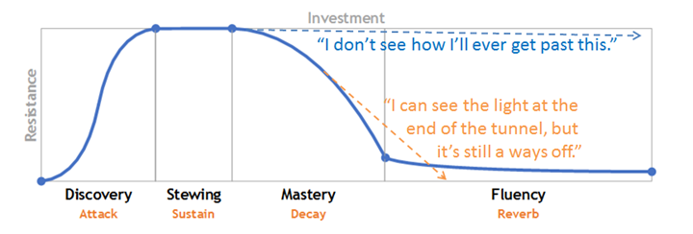

Slide 36
Non Facial
Amusement
Contentment
Excitement
Satisfaction
Sensory pleasure
Pride (Accomplishment)
Guilt
Relief
Embarrassment
Contempt
Shame
Notes:
Lots of other emotions.

Slide 37
Escalation
Requirements: A deck of cards, 4 players.
Setup
Split deck into 4 decks of each suites: hearts, spades, clubs and diamonds. Keep 2 through 7
Discard Jokers, Facecards and 8, 9, 10.
Each player gets a suite.
At the start of the game, all players pick one card and put it in front of them face down.
Play starts with the player to the right of the dealer and continues clockwise.
Players turn
Choice: On a player’s turn, they make a choice.
Ante: They reveal their face down card and put it in the ‘loot pile’ in the center of the table.
Claim: They reveal their card and make it known that they are claiming the point pile.
Countering a claim: If some one makes a claim, the 2 players to their left may reveal their face down card. If their card is a higher value (aces high), they grab the point pile and add it to their point pile.
Losing a claim. If you lose a claim, you put 2 points from your point pile into the loot pile.
Pick new card: At the end of the player’s turn, they pick a new card and place it face down in front of them.
Winning
Play until players have no more cards.
Player with the most points wins.

