Slide 1
Paper Simulations of Digital Games
Stone Librande
Lead Designer, Riot Games

Slide 2
Take a digital game…

Slide 3
…remove the controller…

Slide 4
…remove the controller…

Slide 5
…the sound and music…

Slide 6
…the sound and music…

Slide 7
…and the graphics

Slide 8
…and the graphics

Slide 9
What’s left?

Slide 11
Exercise #2
Simulate a video game using only pencils, index cards and dice.
Use it as a tool to help understand the game’s fundamental design principles.
Don’t sweat the details.

Slide 12
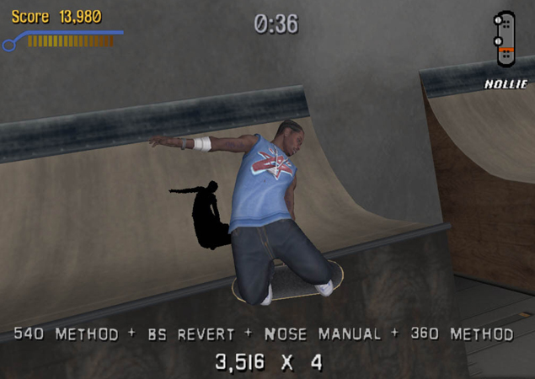
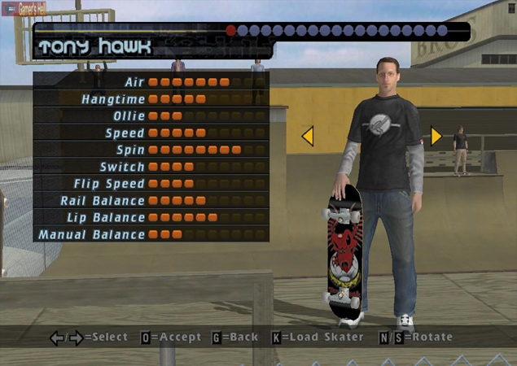
Example Game
Tony Hawk’s Pro Skater

Slide 13
Example Game
Tony Hawk’s Pro Skater

Slide 14
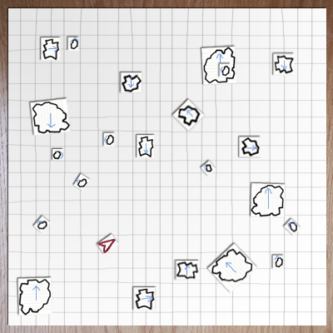
Asteroids

Slide 15
Asteroids

Slide 16
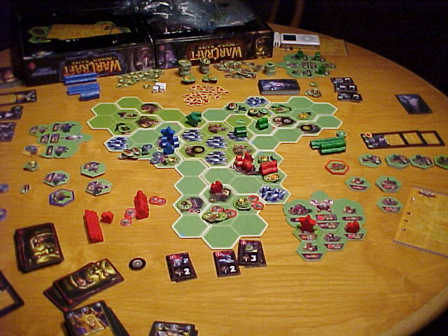
Warcraft
The Board Game

Slide 17
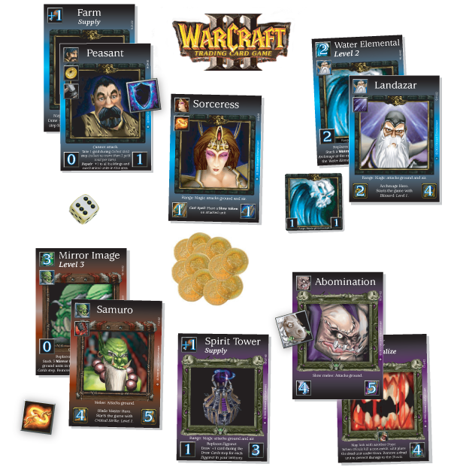
Warcraft
The Card Game
Notes:
Diablo card game
Kill monsters, get treasure, buy better stuff, kill bigger monsters, get bigger treasures…

Slide 18
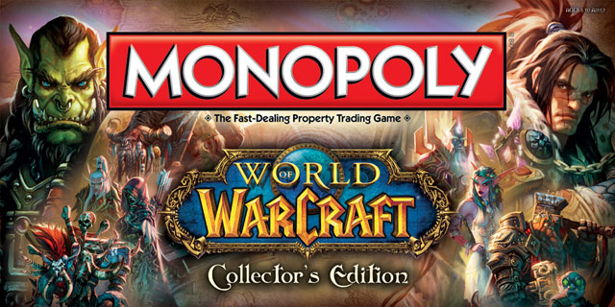
Notes:
Diablo card game
Kill monsters, get treasure, buy better stuff, kill bigger monsters, get bigger treasures…

Slide 19
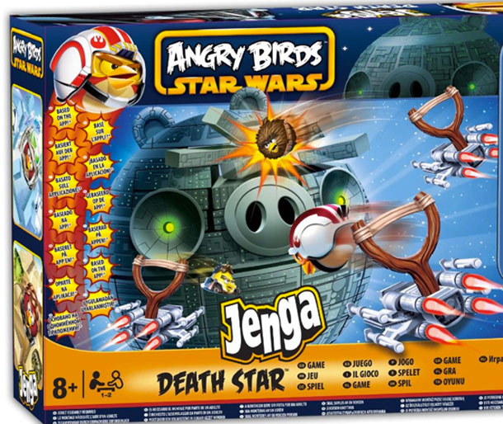

Slide 20
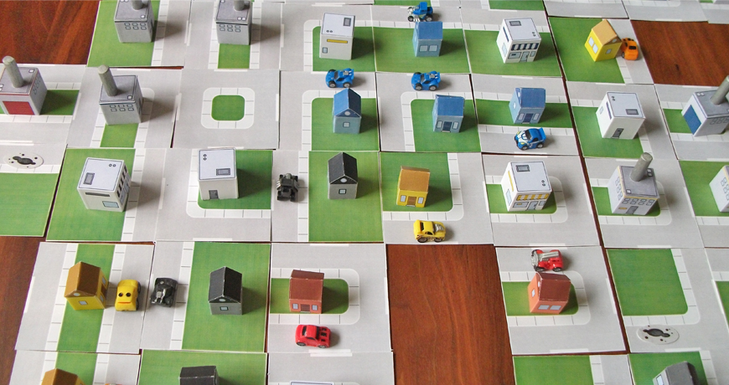

Slide 21
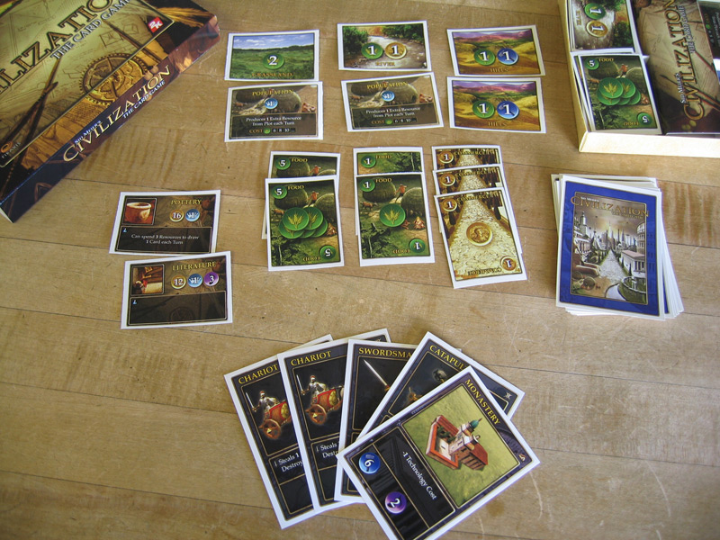
Civilization
The Card Game

Slide 22
Exercise
Select a digital game
Make a paper prototype
What aesthetics survive the change in medium?

Slide 23
Brainstorm
Name some games to “unplug”
Break into groups

Slide 24
Build a Paper Version
What To Do
Identify your game’s play aesthetics
Choose one aesthetic element to capture
Write it down and put it in the middle of your table
Identify the game actions that create that feeling

Slide 25
Build a Paper Version
What Not to Do
Don’t sweat the details
Don’t try to duplicate the whole game
Don’t focus on simulating computer functions
Don’t make a board!

Slide 26
Alpha Deadline at 12:00
Try to have something playable quickly!
Iterate!

Slide 27
Lunch at 12:00
Sign up for electives at:
gdc.8kindsoffun.com
(tinyurl.com/gdc-mda)
Back here at 1:30

Slide 28
Beta Test at 1:45
Get your rules written down.

Slide 29
Beta Test
Send two testers to other tables.
Test until 2:15

Slide 30
Discussion
Let’s share results.
What aesthetics did you capture?
What did you leave out?

Slide 31
The Message
Play transcends media
Mechanics
Dynamics
Aesthetics
Sometimes.

Slide 32
Using Paper Prototypes
Good for understanding existing games.
Use these techniques for games in progress.
Process is quick and cheap.
You don’t need programmers or artists.

Slide 33
Using Paper Prototypes
Can’t replace actual gameplay testing.
Can give you a head start and keep you focused.
Creates a vocabulary to use when discussing your game.
Can be used as a tool to educate other team members. Have them play, too!

Slide 34
Elective B
236: Us vs. It
224: BattleBattle!
220: Three Musketeers

