Slide 1
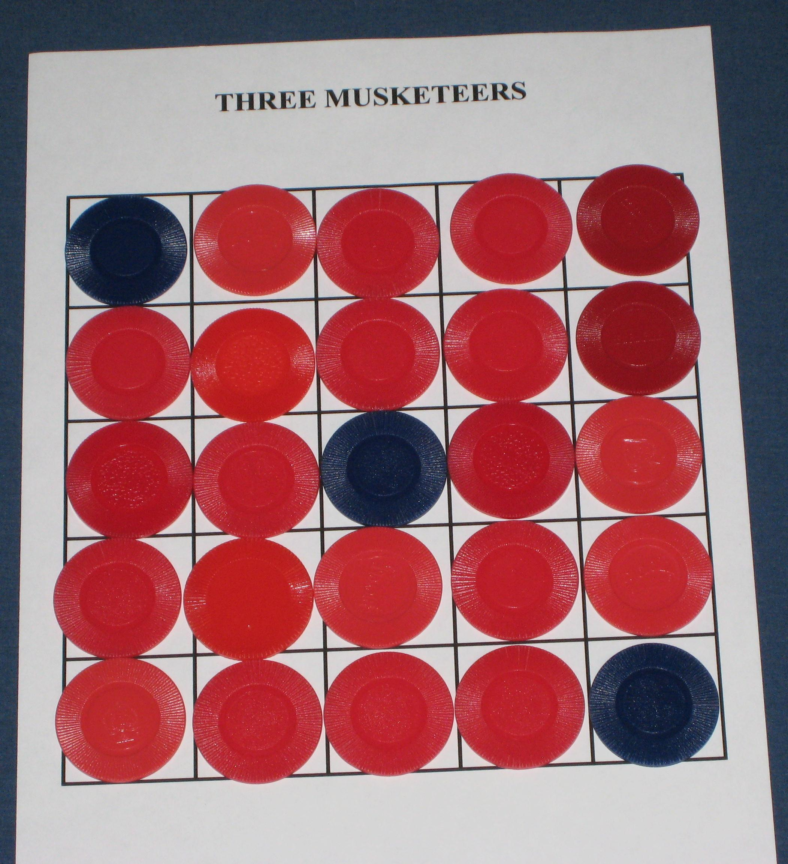
Three Musketeers

Slide 2
Game Rules
One player is the Musketeers
The other is the Cardinal.

Slide 3
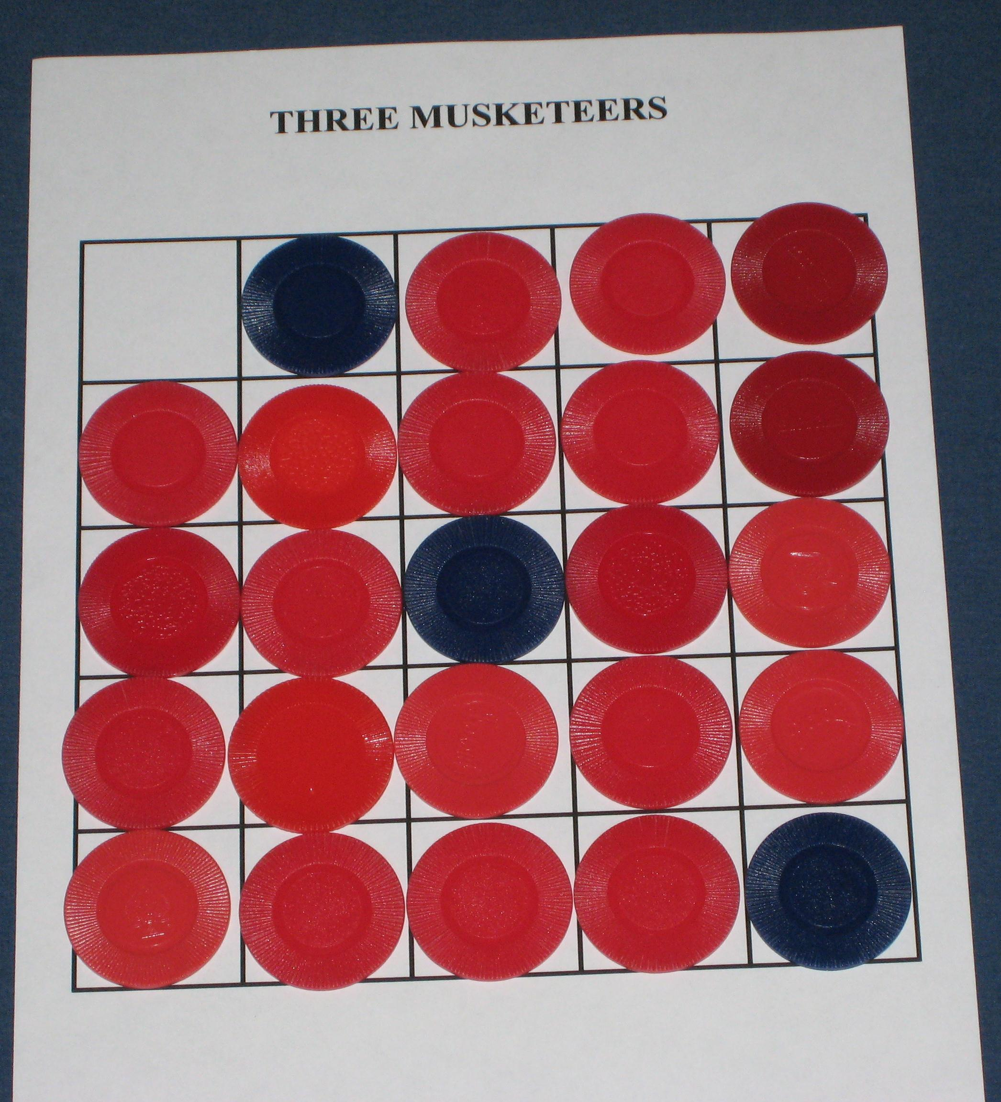
Game Rules
Musketeer player moves by capturing an adjacent enemy piece.

Slide 4
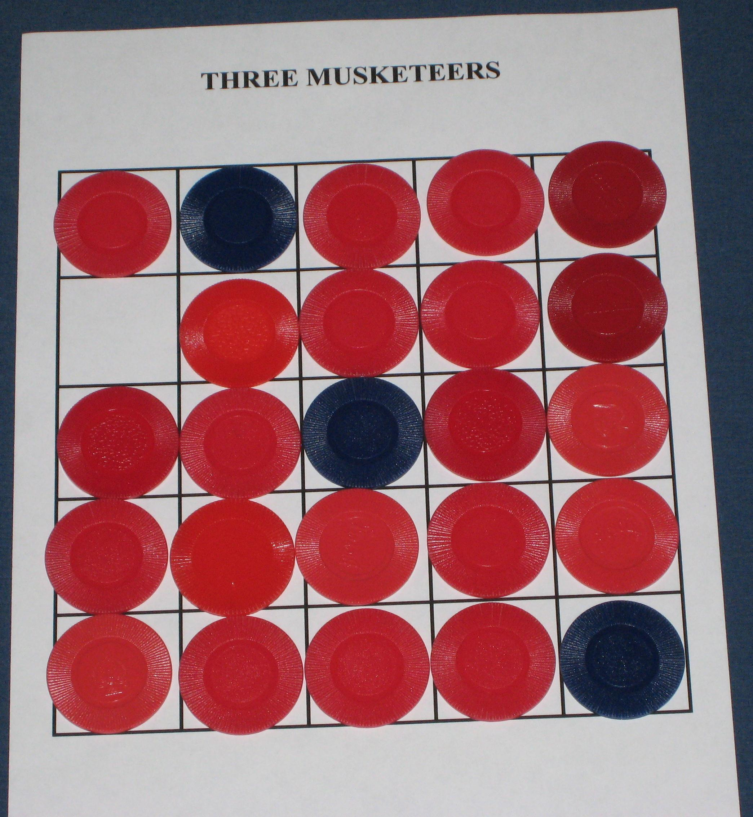
Game Rules
Musketeer player moves by capturing an adjacent enemy piece.
Cardinal player moves by sliding into an adjacent empty space.

Slide 5
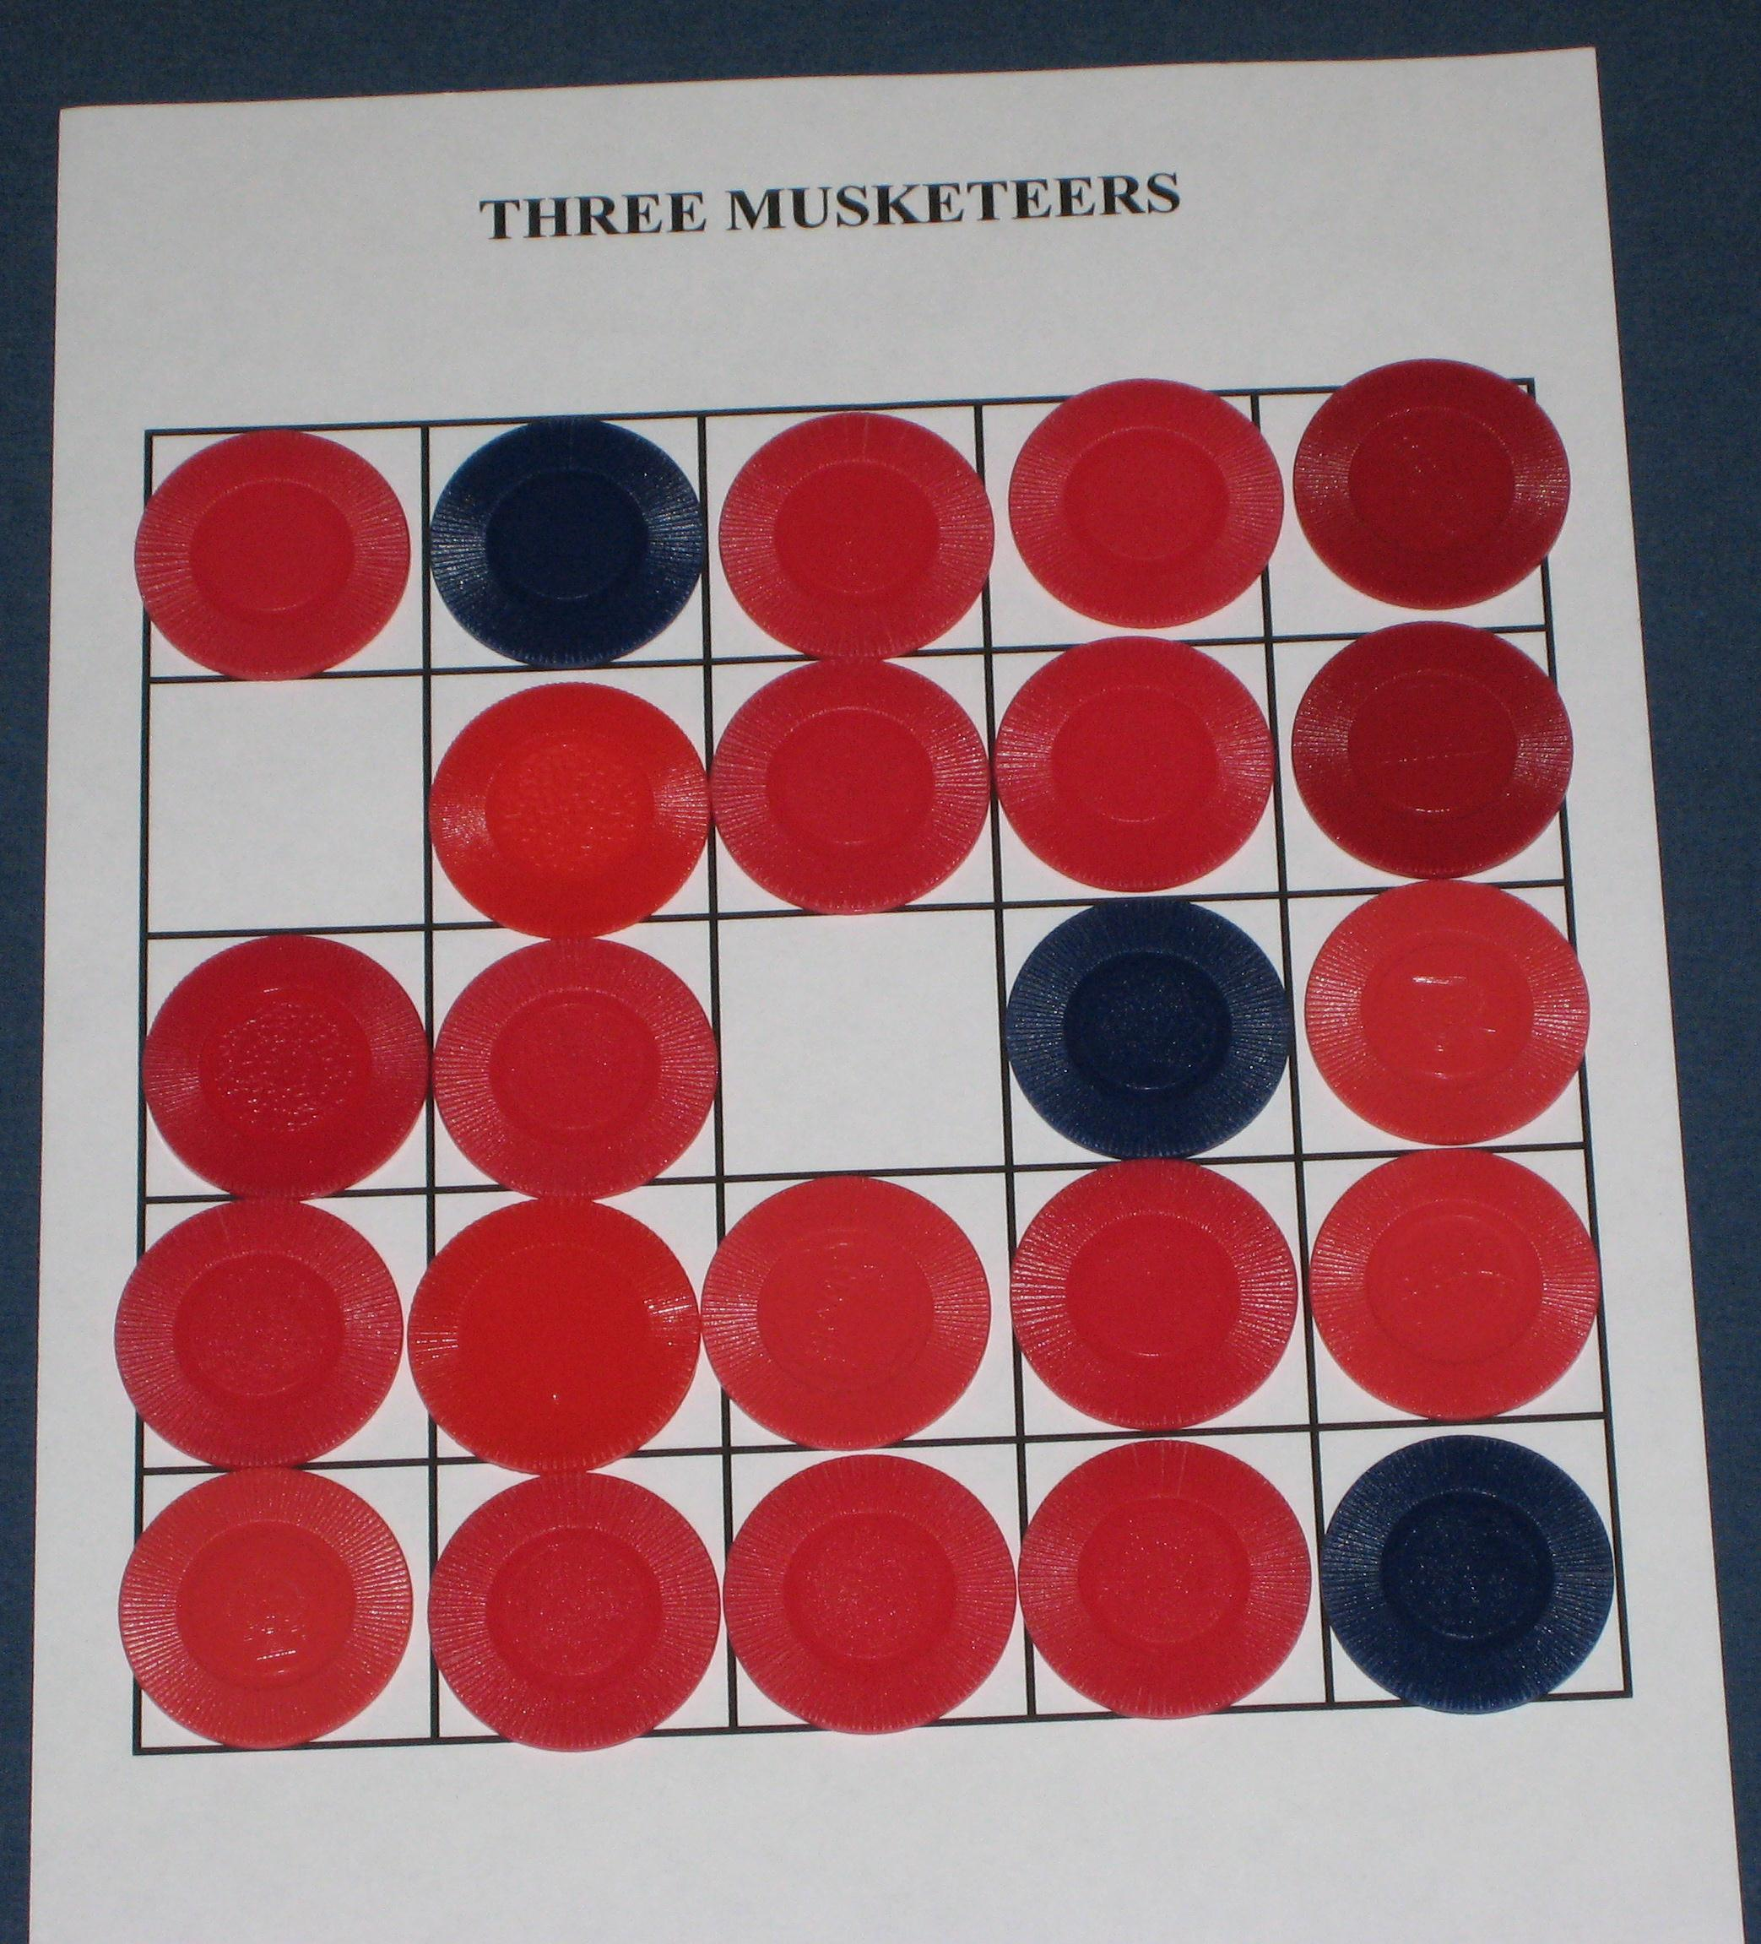
Game Rules
and so on…

Slide 6
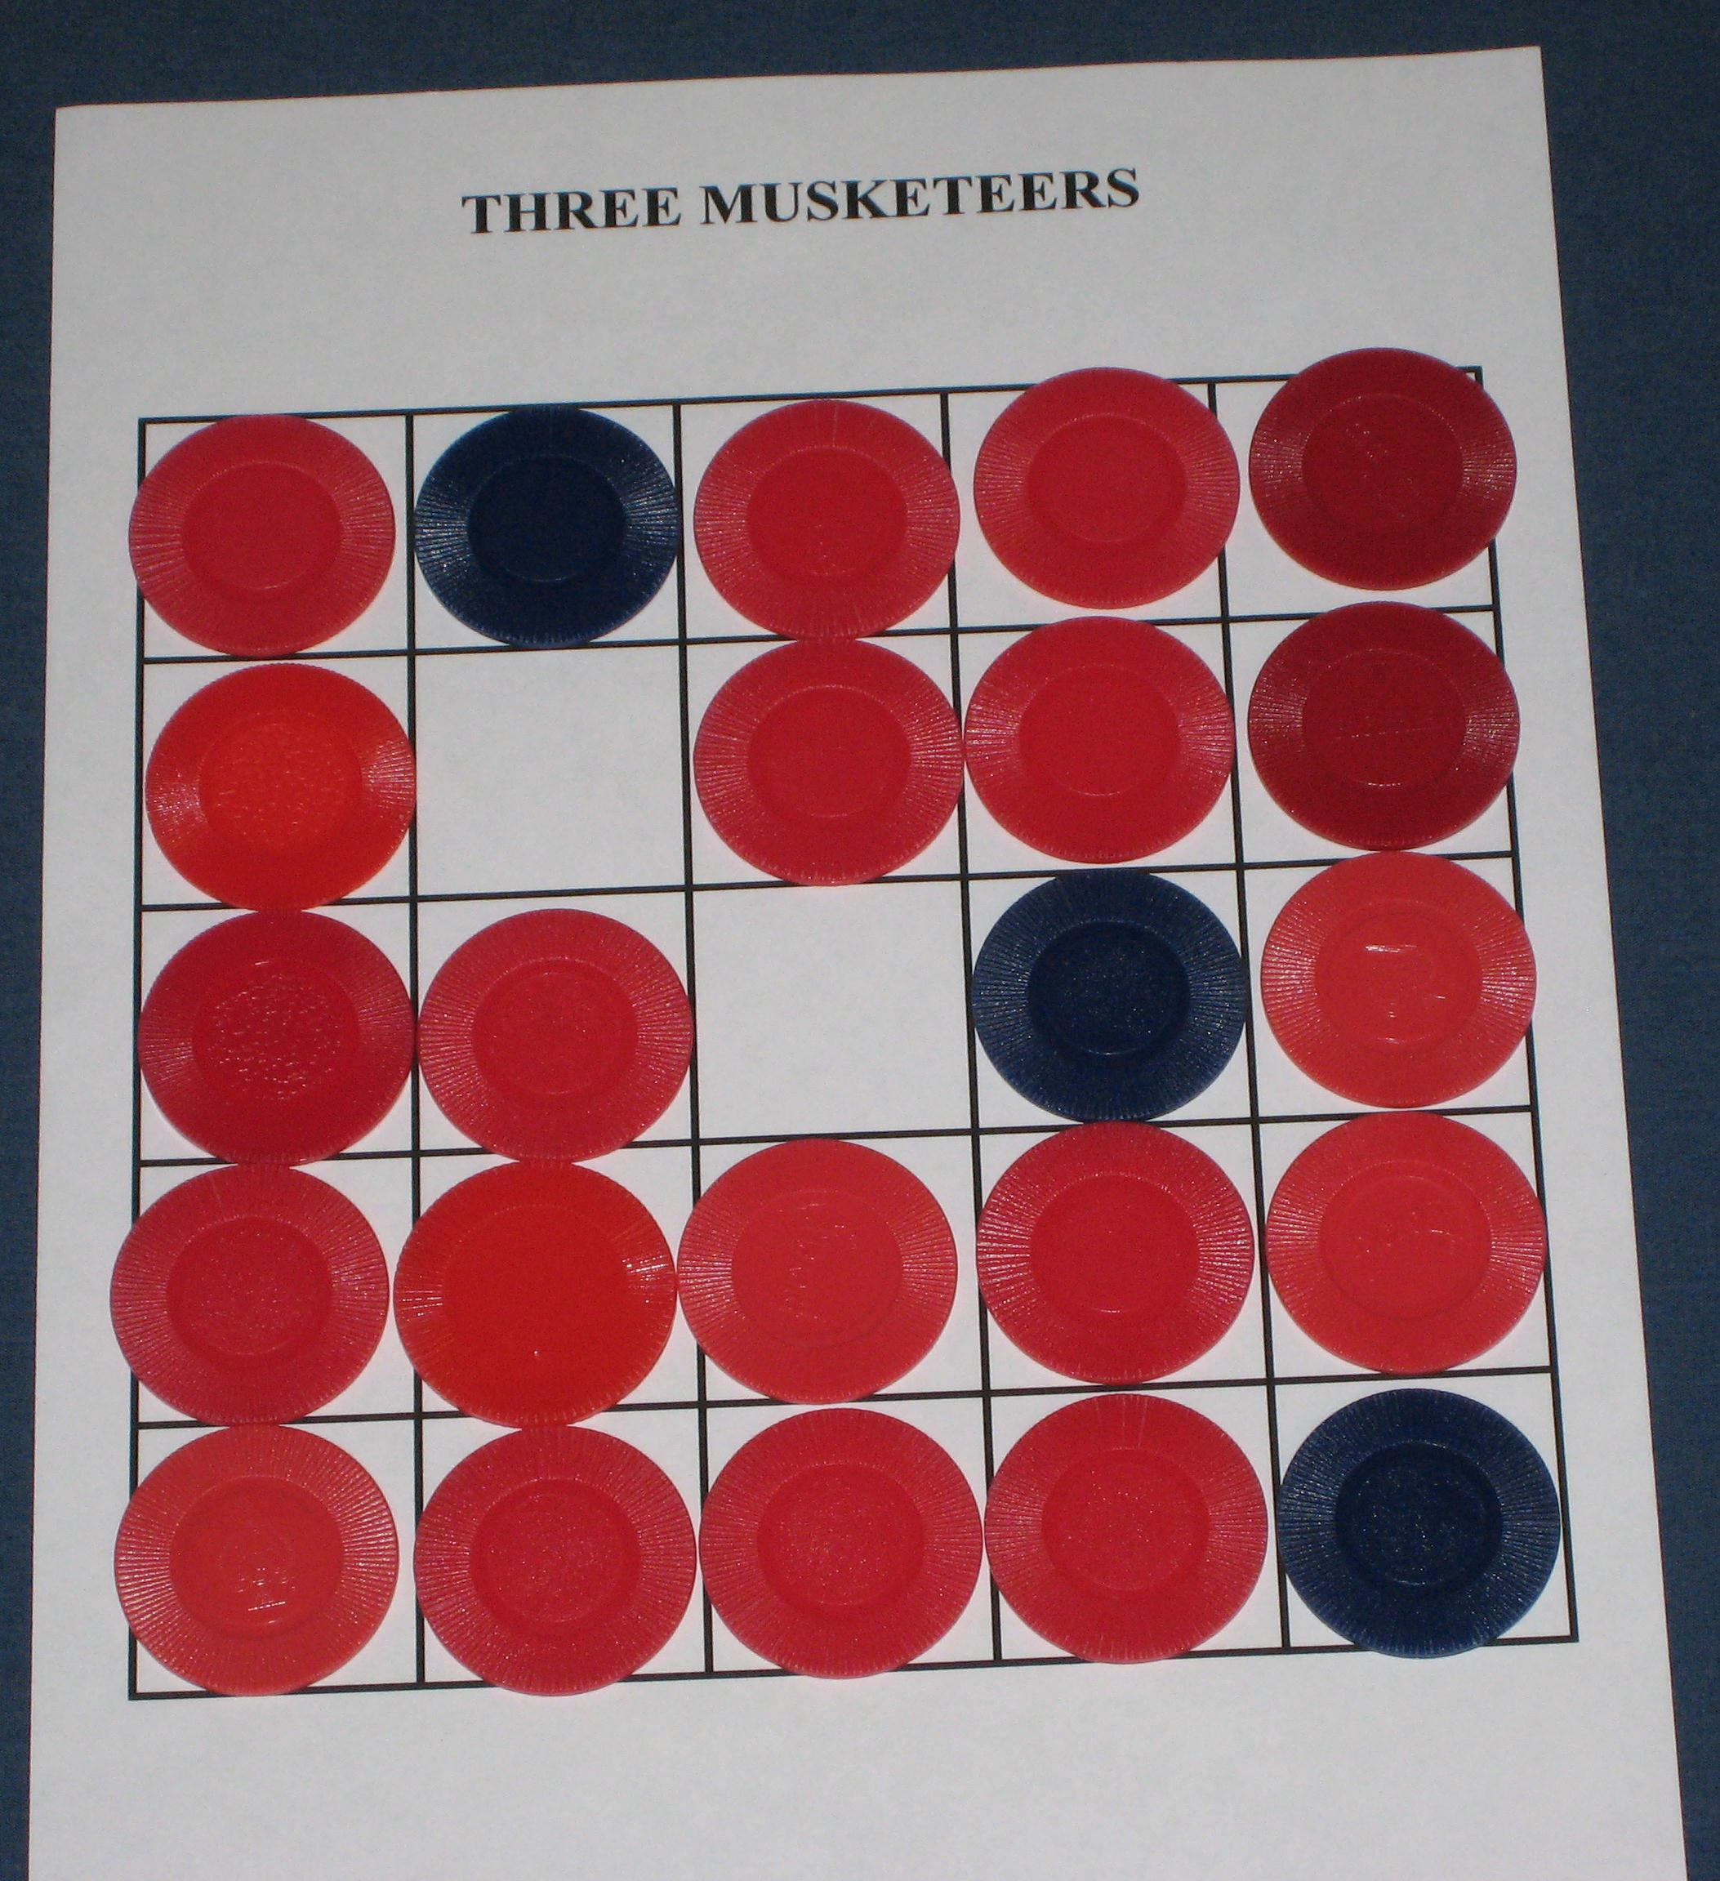
Game Rules
and so on…
and so forth…

Slide 7
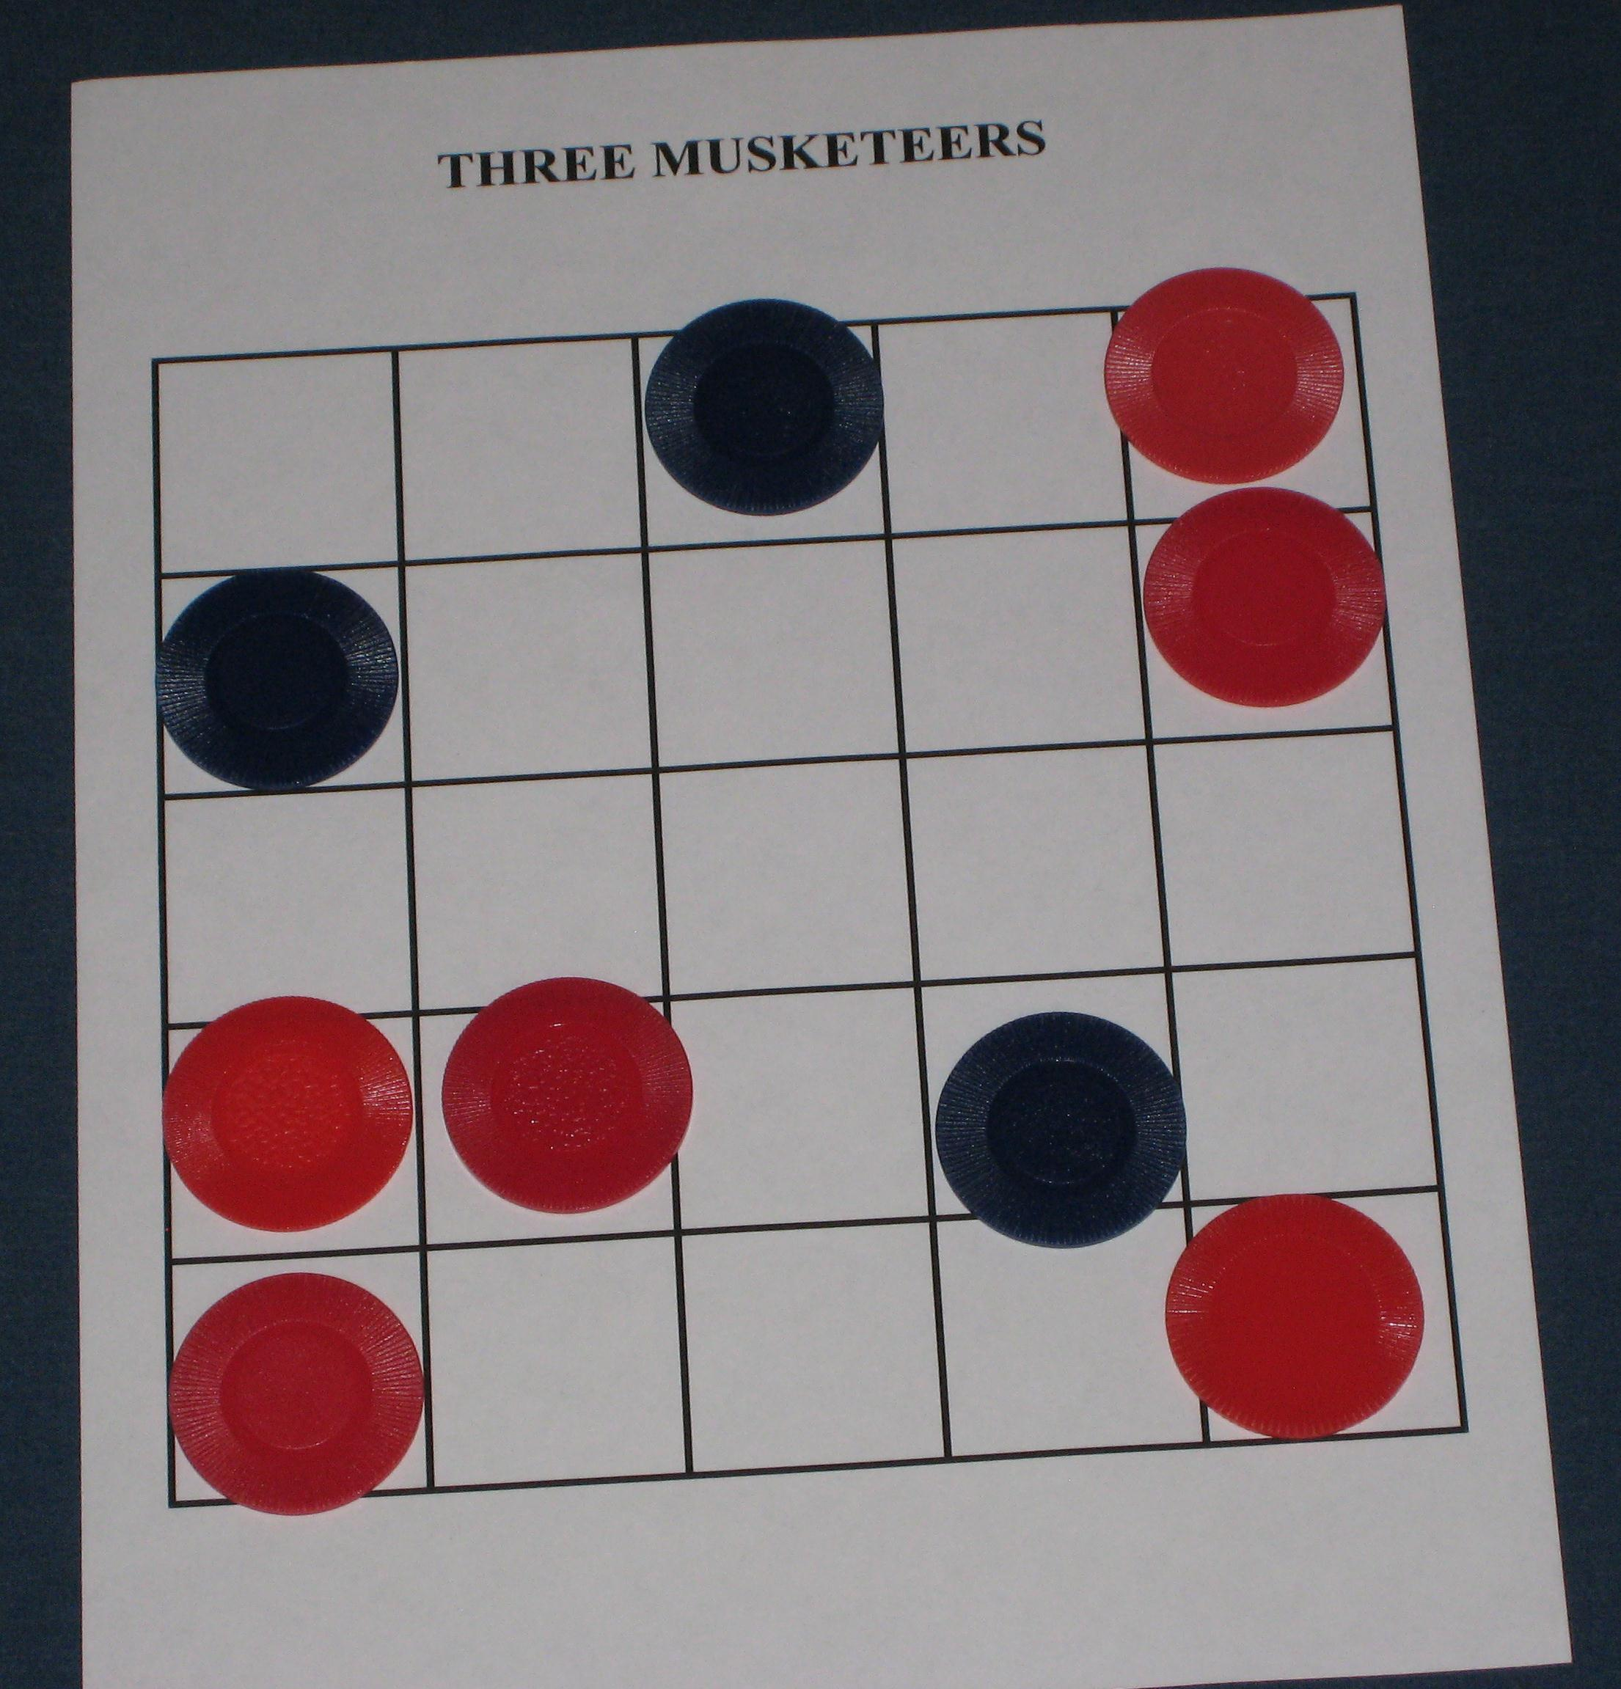
Game Rules
Musketeer wins if he has no adjacent enemies at the start his turn.

Slide 8
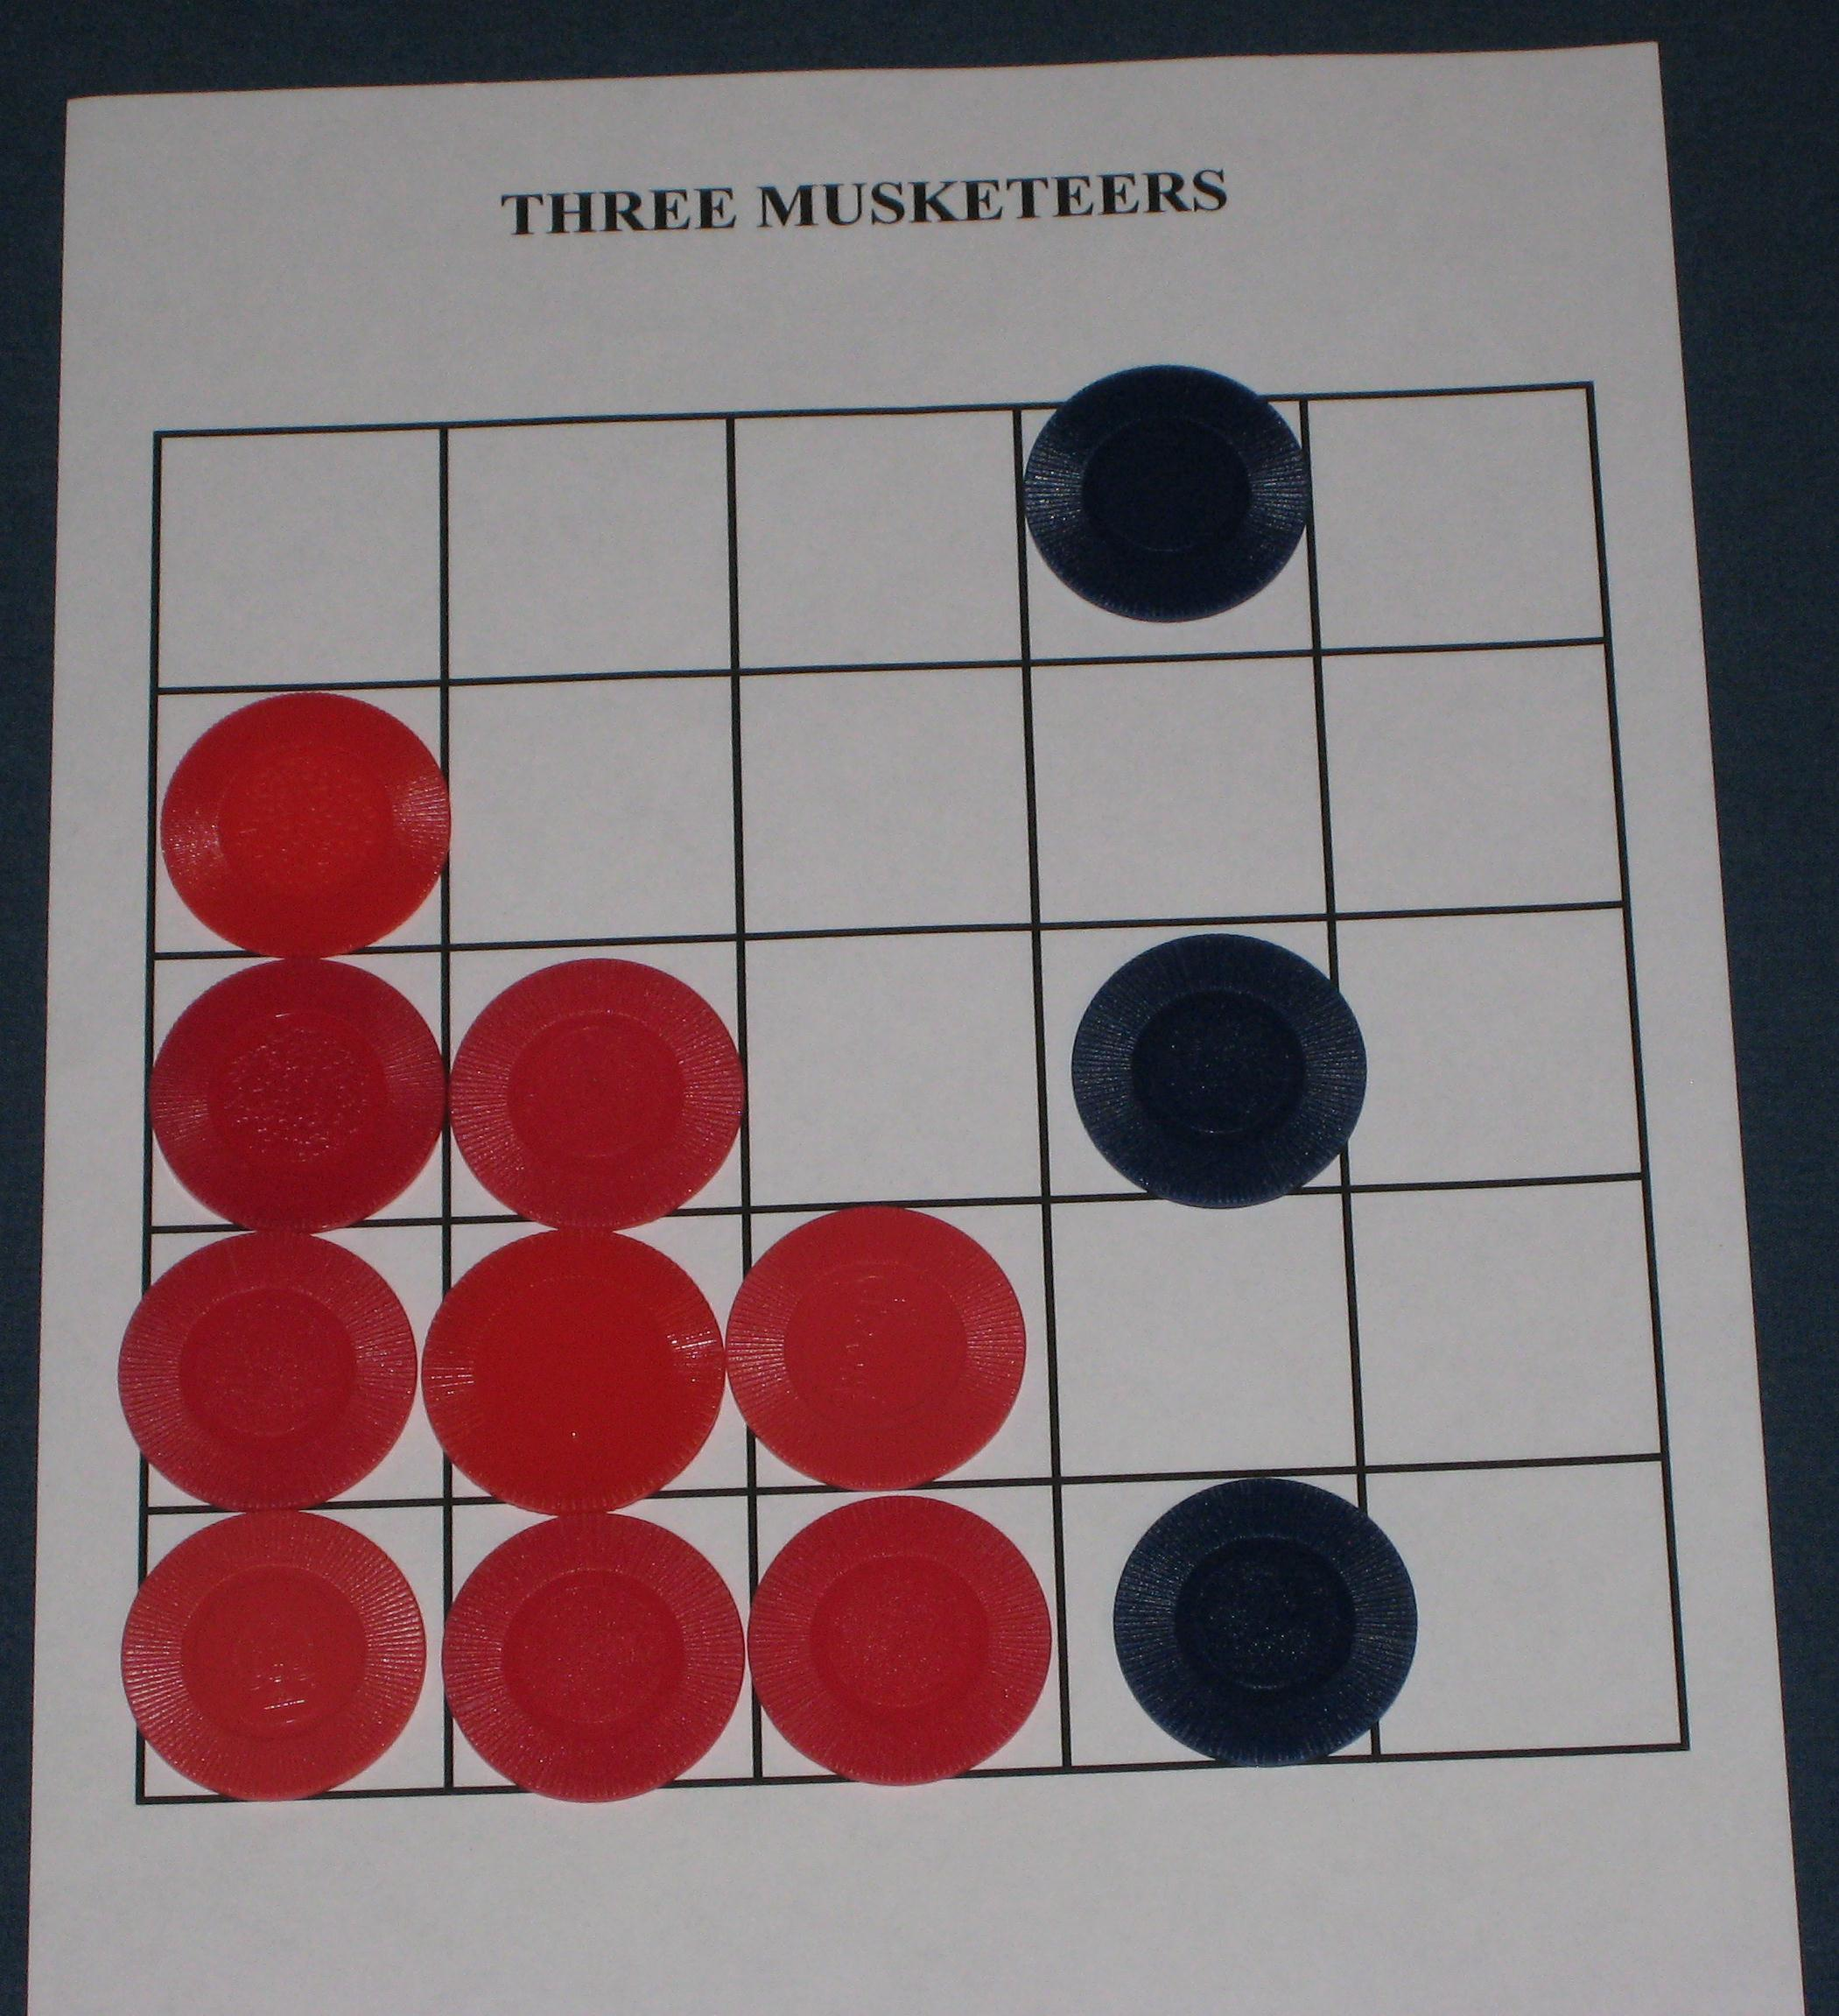
Game Rules
Cardinal wins if all three Musketeers are in the same row or column.

Slide 9
Play until 3:15
Players take turns moving one of their pieces. No diagonal moves.
Musketeers move by capturing a nearby enemy.
Cardinal’s men move to a nearby empty space.
Cardinal wins if the Musketeers are in the same row or column.
Musketeers win if they cannot move.
Starting Board

Slide 10
Observations?
Notes:
5 minutes.

Slide 11
Discussion Questions
What’s a good strategy for the Musketeers? For the Cardinal?

Slide 12
Discussion Questions
What interesting rule variants or modifications can we come up with?
Notes:
This is just a limbering up.

Slide 13
Aesthetic Breakdown
What are the aesthetics of Three Musketeers?
Can we come up with aesthetic models?
Notes:
This is the part where the attendees make the bed that they will eventually have to sleep in. A certain amount of rigor is important here. Don’t let them be vague; make sure you can come up with a model for every aesthetic you identify.
Be sure to observe that the game’s mechanics do a good job of conveying its subject matter without much in the way of visual or textual cues.

Slide 14
Discussion Questions
1. What is the maximum number of choices the musketeer player can have on his turn?
Notes:
Answer on next slide.

Slide 15
Discussion Questions
1. What is the maximum number of choices the musketeer player can have on his turn?
2. ...on his first turn?
Notes:
Answer on next slide.

Slide 16
Discussion Questions
1. What is the maximum number of choices the musketeer player can have on his turn?
2. ...on his first turn?
Notes:
Answer on next slide.

Slide 17
Discussion Questions
1. What is the maximum number of choices the musketeer player can have on his turn?
2. ...on his first turn?
3. ...on his last turn?
Notes:
Answer on next slide.

Slide 18
Discussion Questions
What does this graph look like?
Choices
Time
Notes:
To clarify, the “choices” is the number of musketeer choices, just to keep things simple.
The graph starts at 2, gets bigger, peaks at some point, and then goes back down to around 2.
The point here is that this curve matches the canonical “dramatic structure” curve, and with good reason: Dramatic tension requires uncertainty and more choices permits more uncertainty (you can have choices without uncertainty, but you can’t have uncertainty without choices).

Slide 19
Discussion Questions
What does this graph look like?
Choices
Time
Notes:
To clarify, the “choices” is the number of musketeer choices, just to keep things simple.
The graph starts at 2, gets bigger, peaks at some point, and then goes back down to around 2.
The point here is that this curve matches the canonical “dramatic structure” curve, and with good reason: Dramatic tension requires uncertainty and more choices permits more uncertainty (you can have choices without uncertainty, but you can’t have uncertainty without choices).

Slide 20
Exercise
While remaining faithful to the aesthetic qualities we identified in the breakdown:
Adapt the rules to accommodate 3 players.
Adapt the rules to accommodate 4 players.
Can you come up with a single rules set that accommodates 2-4 players?

Slide 21
Alpha Version due at 4:15

Slide 22
Beta Test at 4:45
Make sure your rules are written down.

Slide 23
Beta Test
Send two testers to other tables.
Beta test until 5:15

Slide 24
Discussion
Let’s compare solutions. What different approaches did we take?
Notes:
Solicit results from each group. Discuss. Give each group 3-4 minutes. About 20 minutes total.

Slide 25
Discussion Questions
How many possible board positions does your game have?
How does it compare to the original game?
Notes:
It’s pretty much impossible to solve this problem without increasing the size of the “state space.” The point here is that having more state space helps the designer by giving him more room to work. A good strategy for this exercise is to increase the state space before even thinking about adding players. (e.g. Use a larger board, etc.) How many groups actually took this strategy?
Don’t spend more than 5 minutes.

Slide 26
Discussion Questions
Consider the problem of adding multiplayer capability to a single-player digital game.
How is this exercise similar?
How is it different?
What about converting a multiplayer game into a massively multiplayer game?
Notes:
I don’t have any expected results here. Though, the massive asymmetry present in 3 musketeers is also present in single-player digital games, so that’s a similarity.
This is sort of an obligatory “tie it back to digital media” question. If it’s not bearing any fruit, move on.

Slide 27
The Message(s)
Drama is emergent
State space is design space
Asymmetry is hard

Slide 28
Any Final Observations?
Notes:
General discussion as time permits. Try to tie it back to digital games.

Slide 29
That’s it!
Please Come to 2020 for the intro to Exercise II.
Wrap up in room 236 at 5:30

