Slide 1
Lanchester’s Laws in Space

Slide 2
Overview
Introduce Lanchester’s Laws
Show a game demo
Go through the math
How to apply to game design

Slide 3
Lanchester’s Laws
Devised by Frederick Lanchester in WW I
Describe the relative strengths of two fighting armies in a war of attrition.
What’s better: more troops or bigger guns?

Slide 4
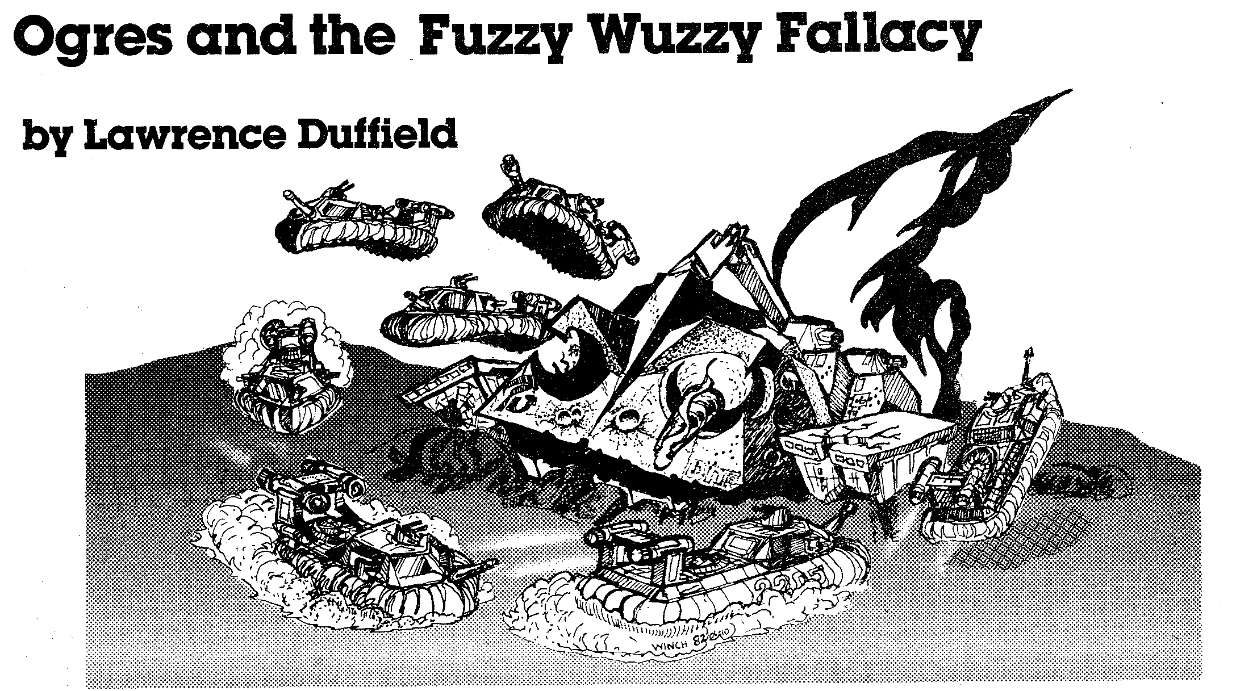
“…a man with a firepower of 2X is not worth twice the value of a man with firepower X, but rather as much, after taking into account one hit on either kills just as dead.”

Slide 5
See Also
The Designer's Notebook: Kicking Butt by the Numbers: Lanchester's Laws
Ernest Adams

Slide 6
Game Demo

Slide 7
Lightspeed Brigade
Lots of different tradeoffs between firepower, hitpoints and # of units.
Need to balance units, but also create R/P/S relationship.
Leave room for future content expansion.

Slide 8
Lanchester’s Laws
Model relationship between numerical advantage (N) and firepower advantage (F)

Slide 9
Example: Fighters vs. Ninjas
Suppose:
Everyone has 10 hitpoints
Ninjas do 1 hitpoint per round.
Fighters do 10 hitpoints per round.
How many Ninjas can a Fighter defeat?

Slide 10
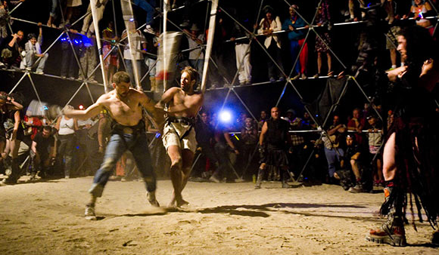
Case 1: Thunderdome

Slide 11
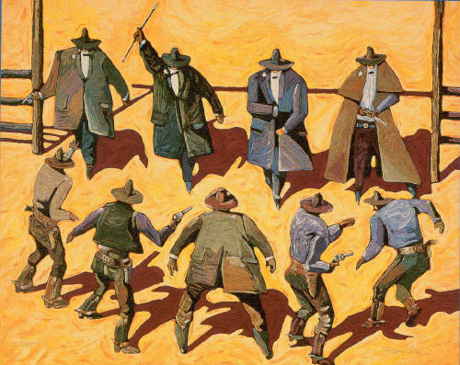
Case 2: Gun Fight

Slide 12
Case 1: Thunderdome
 |  | Ninja HP
 |  | 1 | 2 | 3 | 4 | 5 | 6 | 7 | 8 | 9 | 10 |  | Fighter HP
Start |  | 10 | 10 | 10 | 10 | 10 | 10 | 10 | 10 | 10 | 10 |  | 10
Round 1 |  | 10 | 10 | 10 | 10 | 10 | 10 | 10 | 10 | 10 |  |  | 9
Round 2 |  | 10 | 10 | 10 | 10 | 10 | 10 | 10 | 10 |  |  |  | 8
Round 3 |  | 10 | 10 | 10 | 10 | 10 | 10 | 10 |  |  |  |  | 7
Round 4 |  | 10 | 10 | 10 | 10 | 10 | 10 |  |  |  |  |  | 6
Round 5 |  | 10 | 10 | 10 | 10 | 10 |  |  |  |  |  |  | 5
Round 6 |  | 10 | 10 | 10 | 10 |  |  |  |  |  |  |  | 4
Round 7 |  | 10 | 10 | 10 |  |  |  |  |  |  |  |  | 3
Round 8 |  | 10 | 10 |  |  |  |  |  |  |  |  |  | 2
Round 9 |  | 10 |  |  |  |  |  |  |  |  |  |  | 1
Round 10 |  | 0 |  |  |  |  |  |  |  |  |  |  | 0

Slide 13
Case 1: Thunderdome
Equilibrium:
(Lanchester’s Linear Law)

Slide 14
The Math:
 | Ninjas | Fighters
Damage (kills/round)

Slide 15
The Math:
 | Ninjas | Fighters
Damage (kills/round)

Slide 16
The Math:
 | Ninjas | Fighters
Damage (kills/round)

Slide 17
The Math:
 | Ninjas | Fighters
Damage (kills/round)
Army Size

Slide 18
The Math:
 | Ninjas | Fighters
Damage (kills/round)
Army Size

Slide 19
The Math:
 | Ninjas | Fighters
Damage (kills/round)
Army Size

Slide 20
The Math:
 | Ninjas | Fighters
Damage (kills/round)
Army Size
Casualties Per Round

Slide 21
The Math:
 | Ninjas | Fighters
Damage (kills/round)
Army Size
Casualties Per Round

Slide 22
The Math:
 | Ninjas | Fighters
Damage (kills/round)
Army Size
Casualties Per Round
% Army Lost per Round

Slide 23
The Math:
 | Ninjas | Fighters
Damage (kills/round)
Army Size
Casualties Per Round
% Army Lost per Round

Slide 24
The Math:
% Army Lost per Round
=

Slide 25
The Math:

Slide 26
The Math:

Slide 27
The Math:

Slide 28
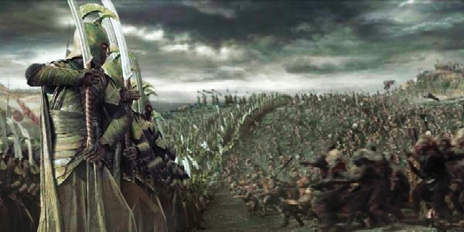
It could be multiple Thunderdomes
1-on-1 fighting is the important property

Slide 29
Case 2: Gun Fight
Combatants gang up for maximum attrition.
No Overkill
No “Underkill”

Slide 30
4 Ninjas vs. 1 Fighter
 |  | Ninja HP
 |  | 1 | 2 | 3 | 4 |  | Fighter HP
Start |  | 10 | 10 | 10 | 10 |  | 10
Round 1 |  | 10 | 10 | 10 |  |  | 6
Round 2 |  | 10 | 10 |  |  |  | 3
Round 3 |  | 10 |  |  |  |  | 1
Round 4 |  | 0 |  |  |  |  | 0

Slide 31
32 Ninjas vs. 10 Fighter
 |  | Ninjas | Fighters
Start |  | 32 | 10
Round 1 |  | 22 | 6.8
Round 2 |  | 15 | 4.6
Round 3 |  | 10 | 3.1
Round 4 |  | 6 | 2.1
Round 5 |  | 3 | 1.5
Round 6 |  | 1 | 1.2
Round 7 |  | 0 | 1.1

Slide 32
One More Ninja
 |  | Ninjas | Fighters
Start |  | 32 | 10
Round 1 |  | 22 | 6.8
Round 2 |  | 15 | 4.6
Round 3 |  | 10 | 3.1
Round 4 |  | 6 | 2.1
Round 5 |  | 3 | 1.5
Round 6 |  | 1 | 1.2
Round 7 |  | 0 | 1.1
 |  | Ninjas | Fighters
Start |  | 33 | 10
Round 1 |  | 23 | 6.7
Round 2 |  | 16 | 4.4
Round 3 |  | 11 | 2.8
Round 4 |  | 8 | 1.7
Round 5 |  | 6 | 0.9
Round 6 |  | 5 | 0.3
Round 7 |  | 4 | 0

Slide 33
Case 2: Gun Fight
Equilibrium:
(Lanchester’s Square Law)

Slide 34
The Math:
 | Ninjas | Fighters
Weapon Damage (kills/sec)
Army Size

Slide 35
The Math:
 | Ninjas | Fighters
Weapon Damage (kills/sec)
Army Size
Total Kills Per Second

Slide 36
The Math:
 | Ninjas | Fighters
Weapon Damage (kills/sec)
Army Size
Total Kills Per Second
% Army Lost per Second

Slide 37
The Math:
% Army Lost per Second
=

Slide 38
The Math:

Slide 39
The Math:

Slide 40
The Math:

Slide 41
The Math:

Slide 42
Lanchester’s Laws
Thunderdome
Gun Fight

Slide 43
Point Value of a Unit
How many Ninjas is a unit worth?
Solve for N.

Slide 44
Point Value of a Unit
Thunderdome
Gun Fight

Slide 45
Variable Hitpoints

Slide 46
Variable Hitpoints
Thunderdome
Gun Fight
2 guys can beat 2x firepower OR 2x health
But not both.
Works for heterogeneous armies.

Slide 47
Two extremes
Thunderdome
Gun Fight
In General

Slide 48
k represents inefficiency
Sources of inefficiency:
Limited range and/or movement
Limited space
Overkill
Underkill
Wikipedia: Modern calculations use k =⅔

Slide 49
Possibly two different k values
Point Value

Slide 50
Factors that Don’t Affect Efficiency
Multipliers on F
fire rate
to-hit chance
Multipliers on H
dodge chance
damage reduction

Slide 51
Factors that Don’t Fit the Model
Healing/Regeneration
Per-hit damage thresholds
Etc.

Slide 52
Back to Lightspeed Brigade
Different ship sizes and ship costs
Rock/Paper/Scissors relationship

Slide 53
Ship Values
Ship | Cost | Fire Rate | Damage | Hit Points
Fighter | 0.2 | 1 | 1 | 5
Cruiser | 2 | 3 | 5 | 35
Dreadnought | 3 | 0.45 | 35 | 75

Slide 54
Point Values (k = .5)
Ship | Cost | Fire Rate | Damage | Hit Points | Point Value | PV/Cost
Fighter | 0.2 | 1 | 1 | 5 | 2.2 | 11.2
Cruiser | 2 | 3 | 5 | 35 | 22.9 | 11.5
Dreadnought | 3 | 0.45 | 35 | 75 | 34.4 | 11.5

Slide 55
Point Values (k = 2/3)
Ship | Cost | Fire Rate | Damage | Hit Points | Point Value | PV/Cost
Fighter | 0.2 | 1 | 1 | 5 | 2.9 | 14.6
Cruiser | 2 | 3 | 5 | 35 | 65.1 | 32.5
Dreadnought | 3 | 0.45 | 35 | 75 | 111.7 | 37.2

Slide 56
Creating Rock/Paper/Scissors
Create match-ups that are inefficient for each side.

Slide 57
Overkill
Ship | Cost | Fire Rate | Damage | Hit Points
Fighter | 0.2 | 1 | 1 | 5
Cruiser | 2 | 3 | 5 | 35
Dreadnought | 3 | 0.45 | 35 | 75

Slide 58
Range
Ship | Cost | Fire Rate | Damage | Hit Points | Range
Fighter | 0.2 | 1 | 1 | 5 | 50
Cruiser | 2 | 3 | 5 | 35 | 65
Dreadnought | 3 | 0.45 | 35 | 75 | 100

Slide 59
AI changes were needed
Dreadnoughts: Don’t bother shooting at fighters.
Cruisers: Change targets quickly. Only steer at one target.

Slide 60
Explicit R/P/S Mechanics Avoided
One less rule to learn
Leave room for future expansion

Slide 61
If it’s R/P/S, why do Point Values matter?
You could end up with a “lopsided” R/P/S:
Rock beats Scissors handily
But Paper beats Rock just barely.

Slide 62
To Sum Up
“Thunderdome” and “Gun Fight” have perfect solutions.
Your game lies between them.
Lanchester’s laws can give you a head start on point values.
Still no substitute for playtest.
Spreadsheets are awesome.

Slide 63
Questions?

